Slide 1
The Progressive Era 1890-1920
The Progressive Era was a period of social and political reform.

Slide 2
Why is it important: Progressivism brought reforms that still affect our society today.

Slide 3
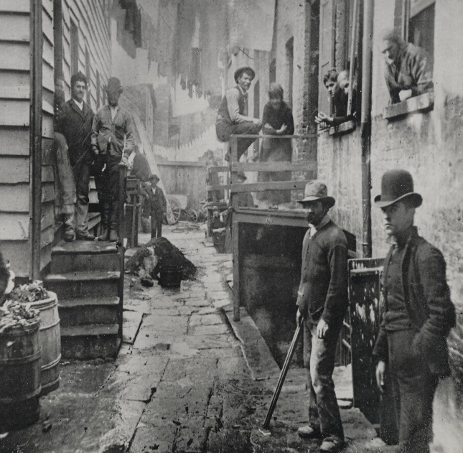
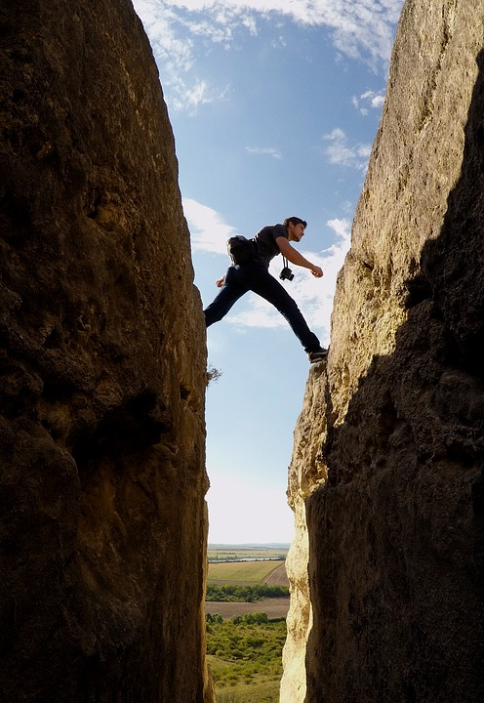
Vocabulary
City Slum
Corruption
GAP

Slide 4
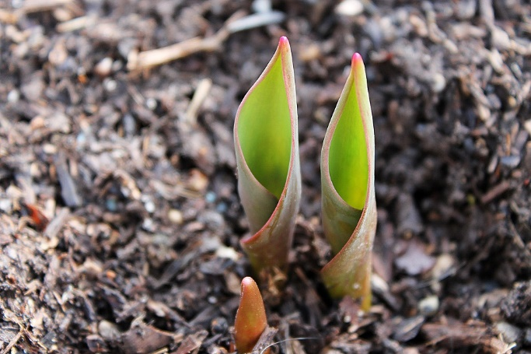
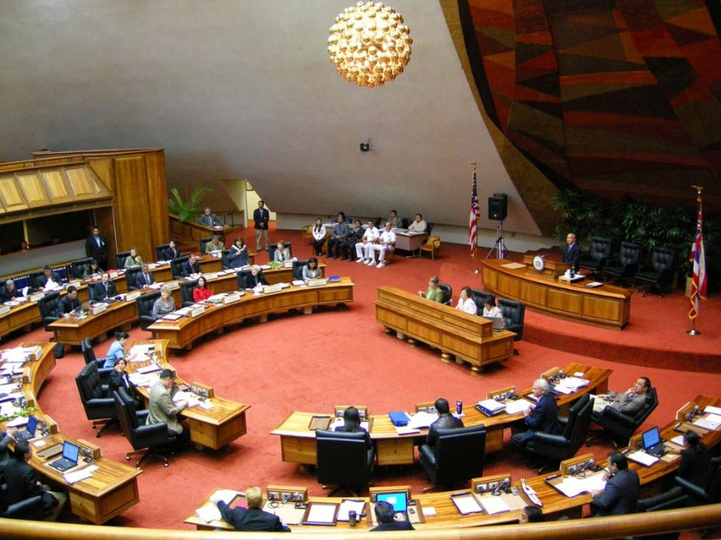
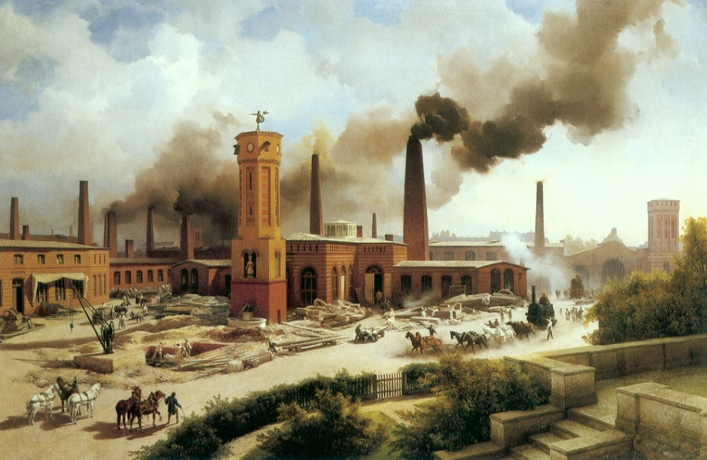
Vocabulary
To emerge State legislatures
Industrialization

Slide 5
Progressivism
When:
1890-1920
Causes:
There were many challenging social and political problems:
corrupted government
child labor
growing gap between the wealthy and the poor
bad conditions for the poor living in city slums
Effects:
Reforming government
Protecting children and improving education for them
Improved working conditions for: miners and factory workers
More rights for women

Slide 6
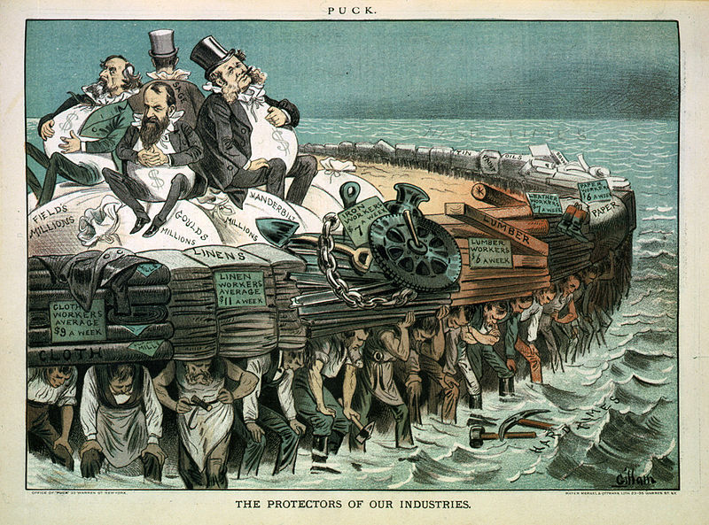
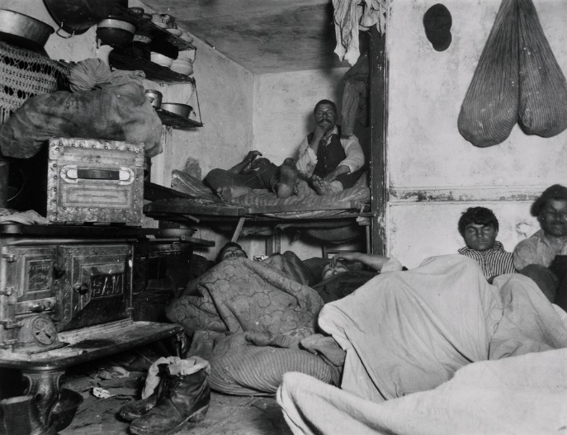
Muckrakers
Journalists and writers wrote about bad conditions in the country.
Lincoln Steffens published the Shame of the Cities about political corruption.
He wrote that politician won by bribing voters.
Jacob Riis, took photographs of crowded, rat-infested tenement buildings.

Slide 7
Checking for understanding
Main idea
Supporting details
Protecting Children
More rights for women
Reforming government

Slide 8
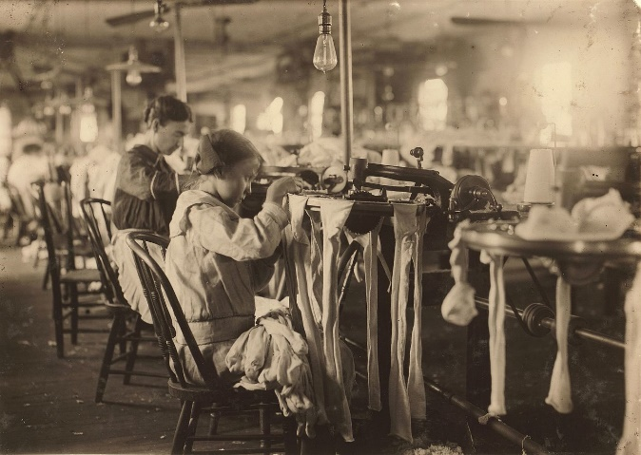
Compare/ contrast Life of children Progressive era vs. 21st century
Progressive era
21st century

