Slide 1
Moulding
Split Pattern Moulding

Slide 2
What is Mould?
A mold is made by shaping a suitable sand mixture around a pattern of the desired form.
A metal or wood box (flask) is used to retain the sand, has two parts Cope & Drag.

Slide 3
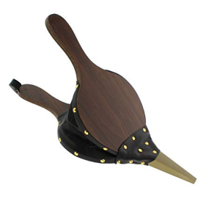
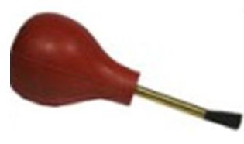
MOLDING TOOLS AND ACCESSORIES
Bellows
Molder's Bulb
Spoon-and-Gate
Cutter

Slide 4
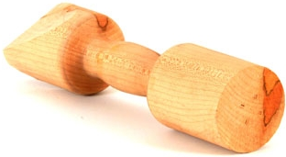
5. Trowel
6. Lifter
7. Hand Rammer
8. Shovel

Slide 5
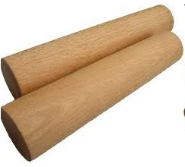
9. Riser Pin
10. Draw Spike & Draw Screw
11. Gate Cutter

Slide 6
12. Strike-Off Bar
13. Spruce Cutter

Slide 7
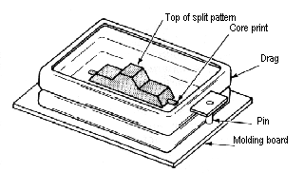
Step 1
First, the drag is placed pin down on a molding board. Then, half of the split pattern is placed in the center of the molding board.

Slide 8
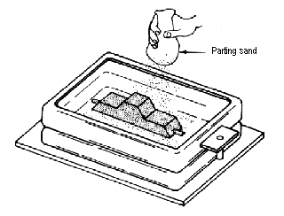
Step 2
A fine parting sand is dusted over the pattern.

Slide 9
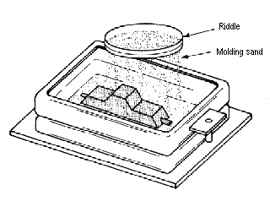
Step 3
Molding sand is riddled to a depth of about one inch over the pattern.

Slide 10
Step 4
Additional sand is added to fill the drag. A hand rammer is used to firmly pack and ram sand.

Slide 11
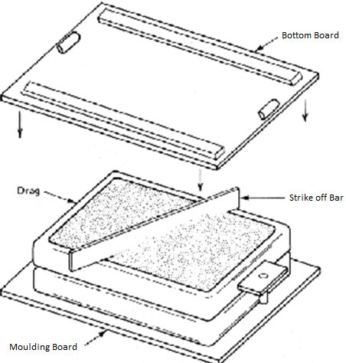
Step 5
The mold is struck off or leveled with the strike-off bar.
Bottom board is placed on the top of the mold.

Slide 12
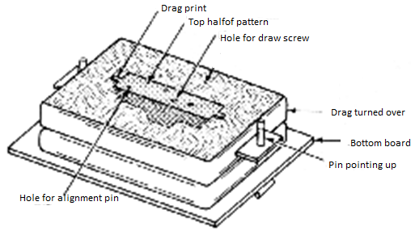
Step 6
The drag is turned over and the mold board is removed.

Slide 13
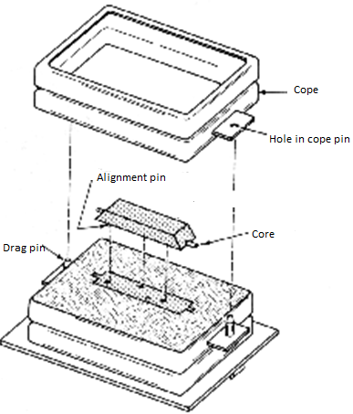
Step 7
The cope is placed on the drag pins. Then, the second half of the pattern is aligned using the alignment pins.

Slide 14
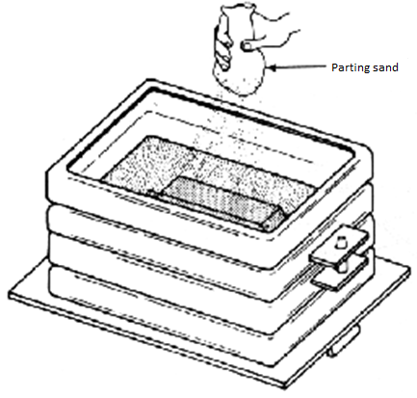
Step 8
The pattern is dusted lightly with the parting sand.

Slide 15
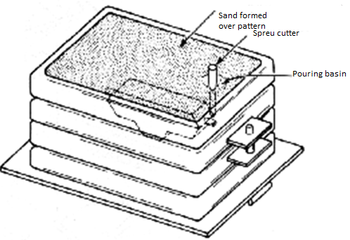
Step 9
First, the pattern in cope is riddled with molding sand and rammed.
Then, sprue is cut in the cope (a vertical hole) down to the parting line and the pouring basin is formed at the top of the sprue.
Finally, a riser hole is also cut at this step.

Slide 16
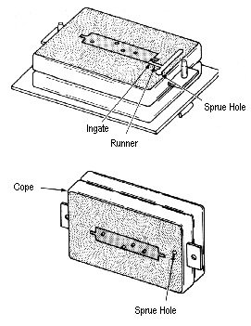
Step 10
Cope and drag are separated and runners and in-gates are cut to connect the sprue hole to the mold cavity.

Slide 17
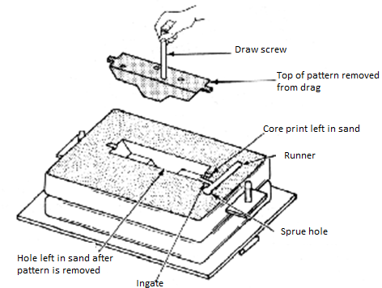
Step 11
First, A draw screw is inserted in the pattern and rapped lightly to loosen the pattern. Then the split patterns are carefully removed from the cope and drag.

Slide 18
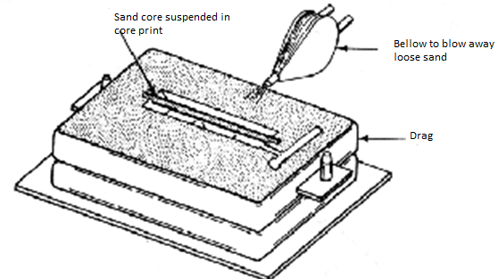
Step 12
Repairs and removal of foreign particles and placement of cores.

Slide 19
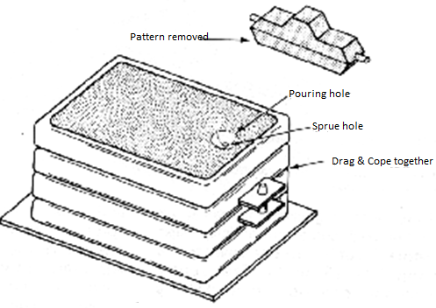
Step 13
The Cope is carefully placed on the drag and the finished mold is taken to pouring area.

Slide 20
Assignment
Now you are going to make a spilt pattern mould in the shop.

