Slide 1
Scientific Method
Identify a problem or a question
Identify variables
Independent: changed by the scientist
Dependent: changes according to the independent variable
Controlled: the same throughout the experiment
Make a hypothesis
Observation and collection of data
Analysis and presentation of data ( tables, graphs, written explanations)
Make conclusions
Data supports hypothesis
Data does not support hypothesis

Slide 2
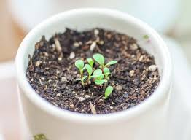
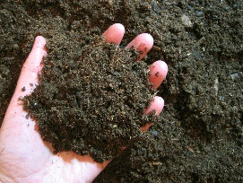
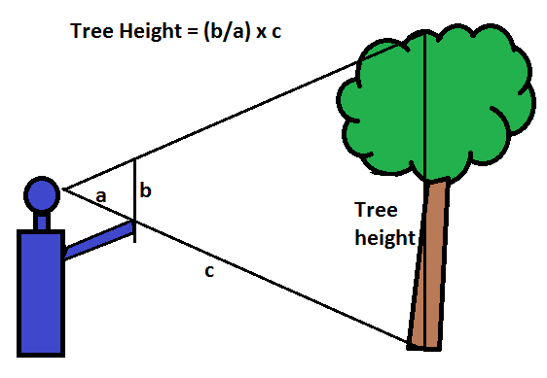
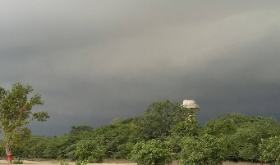
Scientific Method Vocabulary
Word | Definition | Example
Hypothesis | An educated guess about the result of an experiment | If we use dark soil, then the plant with dark soil will grow taller than plant without it.
Independent variable | The part of an experiment that is being tested or the part that is changed by the person doing the experiment | Soil
Dependent variable | The part of the experiment that is affected by the independent variable | Size of the plant, how tall it gets
Inference | Making a conclusion from an observation or evidence. | It will rain soon.
Observation | Using your five senses to obtain information (touch, hearing, vision, smell, and taste) | It is cloudy.

