Slide 1
Introduction to Metal Casting

Slide 2
Metal Casting
Why casting ?
Basic terms used in casting.

Slide 3
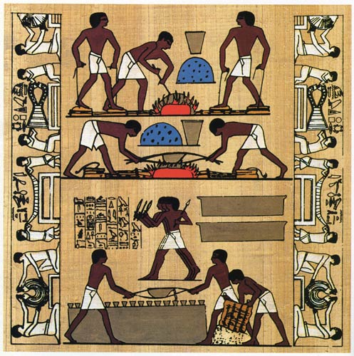
Early History
The oldest known cast in existence is a copper frog from 3200 BCE in Mesopotamia.
Other early casts from around 3000BCE like weapons and cult objects were discovered in the Middle East and India.

Slide 4
Introduction
Casting is a process based on the property of liquid to take up the shape of the vessel containing it.
A rigid frame/cavity into which liquid metal is poured to form a casting is called a Mold.
Carried out in a foundry.

Slide 5
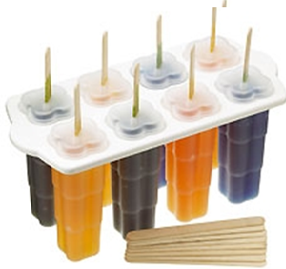
Have you seen any similar process before?
Iced Lolly
What do we control?
Size & shape of cavity and mold
Mixture composition
Temperature
Cooling time
Carefully remove it

Slide 6
What is Sand Casting?
Sand Casting is a process in which a cast is formed from a molten metal in a sand mold.
Can be used to produce a range of sizes from a fraction of an ounce to hundreds of tons.

Slide 7
Casting Process
Material is heated/melted
Heated to proper temperature
Treated to modify its chemical makeup
Molten material is poured into a mold
Solidifies

Slide 8
Advantages of Casting
Complex shapes
Parts can have hollow sections or cavities
Very large parts
Intricate shaping of metals that are difficult to machine
Different mold materials can be used
Sand, metal, or ceramics
Different pouring methods

Slide 9
Disadvantages of Casting
Empty spaces can weaken metal
Poor surface finish
Small parts hard to remove
Additional hardening usually needed

Slide 10
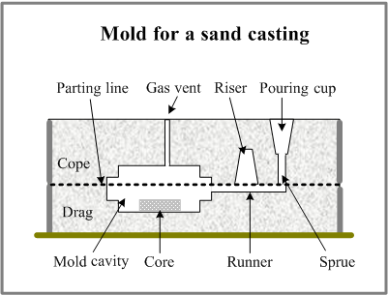
General Sand Casting
Two-piece casting flask
top is cope, bottom is drag
Sand packed around pattern of intended shape
Gating system for metal flow and escape
trimming necessary
Often used with automotive parts and piping
Iron, steel, bronze, aluminum, lead, tin, zinc

Slide 11
Six basic steps of casting
1. Mold cavity is produced having the desired shape and size of the part
Takes shrinkage into account
Single-use or permanent mold
2. Melting process
Provides molten material at the proper temperature
3. Pouring technique
Molten metal is poured into the mold at a proper rate to ensure that erosion and or defects are minimized

Slide 12
Six Basic Steps of Casting
4. Solidification process
Controlled solidification allows the product to have desired properties
Mold should be designed so that shrinkage is controlled
5. Mold removal
The casting is removed from the mold
Single-use molds are broken away from the casting
Permanent molds must be designed so that removal does not damage the part
6. Cleaning, finishing, and inspection operations
Excess material along parting lines may have to be machined

Slide 13
Casting Terminology
Pattern- Replica of the desired part
Molding material- material that is packed around the
pattern to provide the mold cavity
Flask- rigid frame that holds the molding aggregate
Mold cavity- combination of the mold material and cores
Riser-additional void in the mold that provides additional metal to compensate for shrinkage

Slide 14
Casting Terminology
Gating system- network of channels that delivers the molten metal to the mold
Pouring cup- portion of the gating system that controls the delivery of the metal
Sprue- vertical portion of the gating system
Runners- horizontal channels
Gates- controlled entrances

Slide 15
Video
https://www.youtube.com/watch?v=XlRK_SMWX7Y

Slide 16
Any Questions!!

