Slide 1
Materials and Project Estimation
Mr. Zimmerman
Gillett Secondary

Slide 2
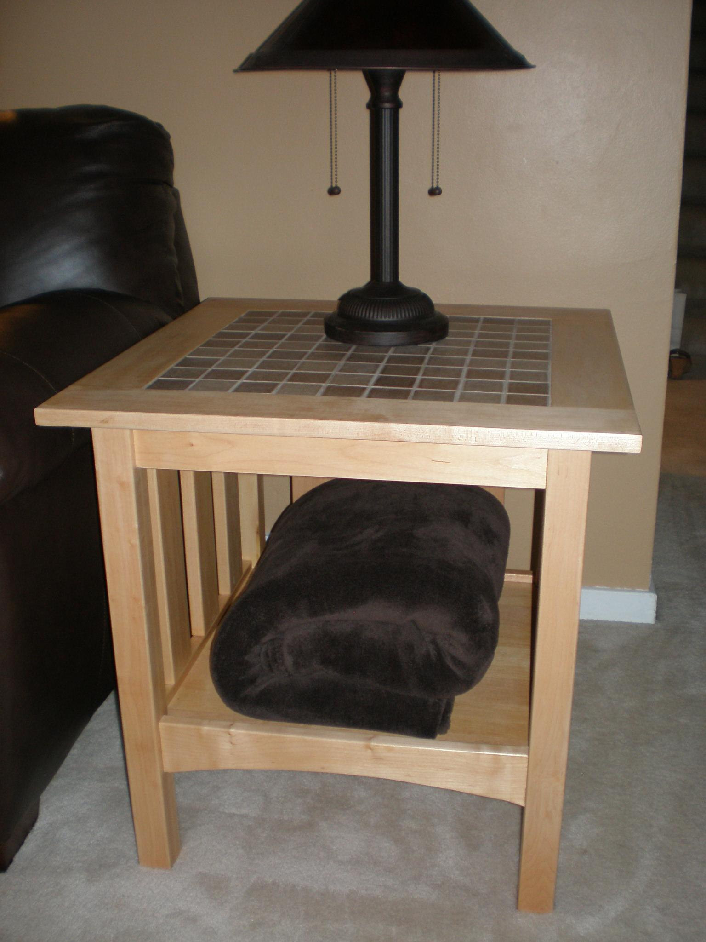
Vocab
Board Feet
Square Feet
Linear Feet
Dimensional Lumber
Sheet Stock
Hardware

Slide 3
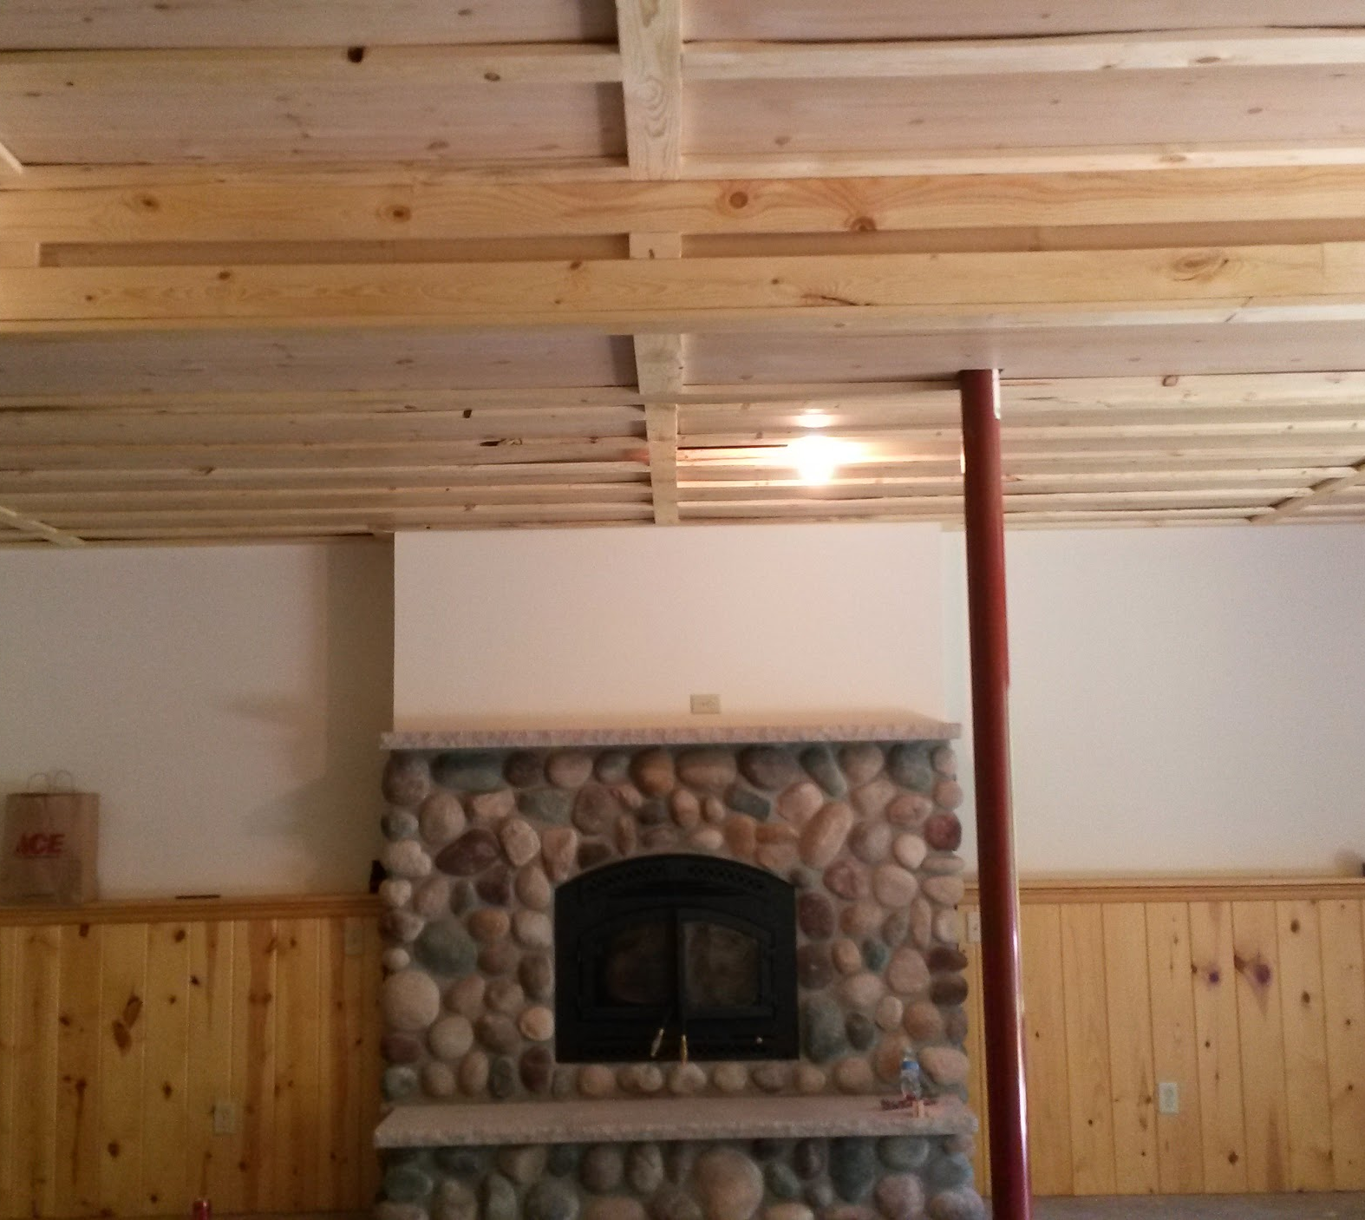
Objectives
Identify various species of wood and their uses.
Identify different sheet materials and their uses.
Calculate materials to complete a project.

Slide 4
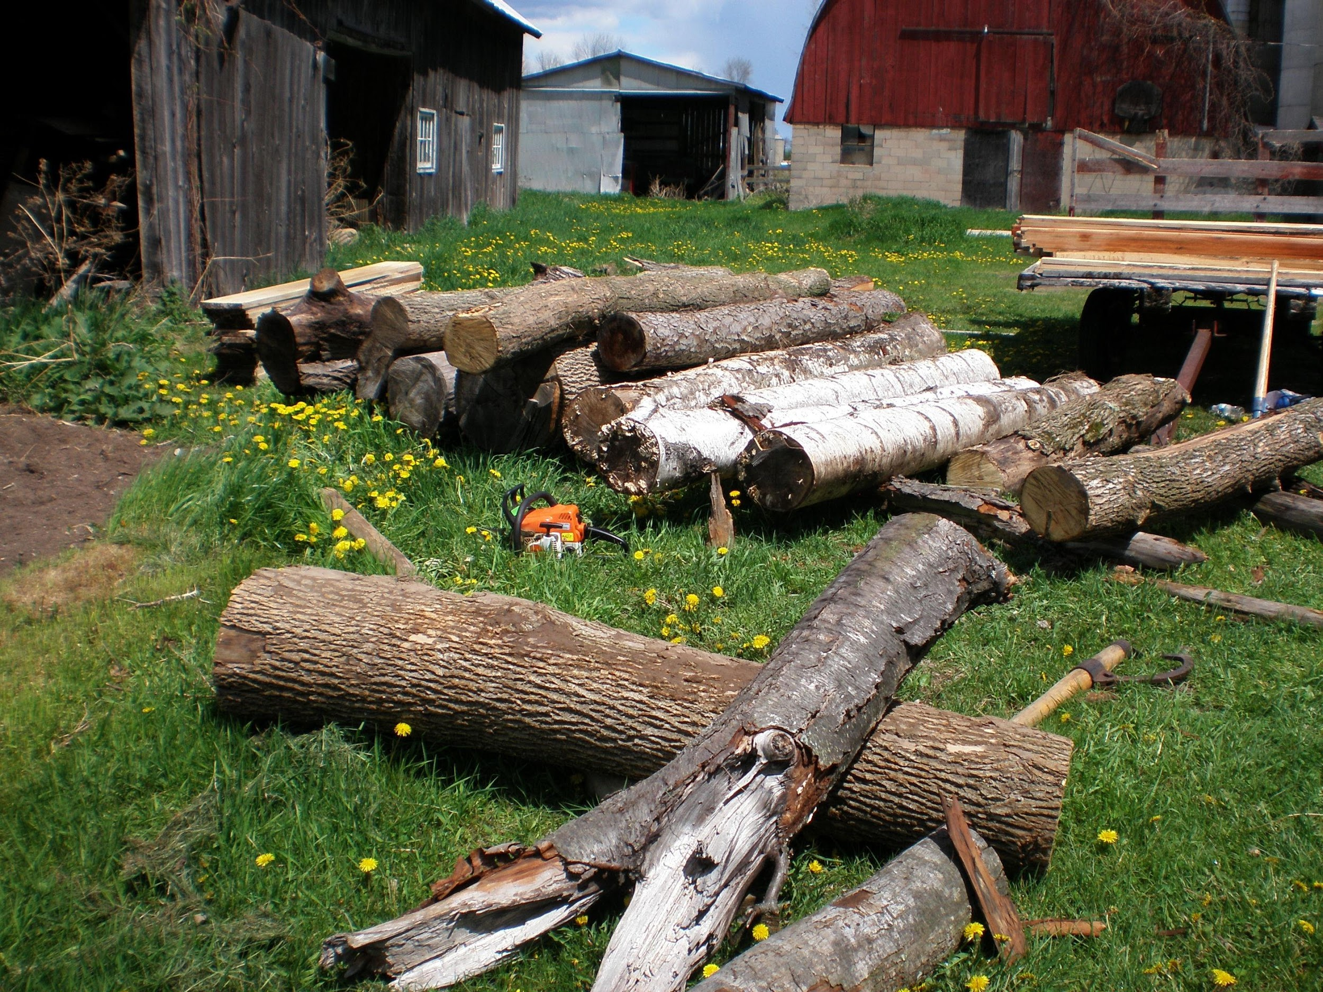
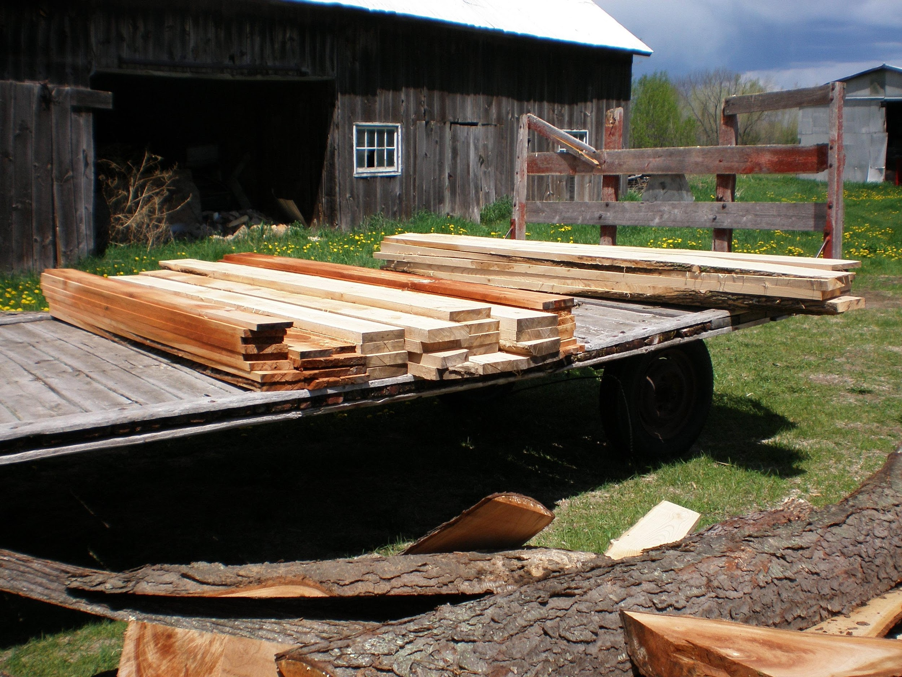
Dimensional Lumber
Actual boards from a tree
Can have different species or grading
Usually random length and width

Slide 5
Hardwood vs Softwood
Hardwood- Deciduous -
Softwood- Coniferous-
A softwood can be harder that a hardwood
Ex: Hemlock and Poplar

Slide 6
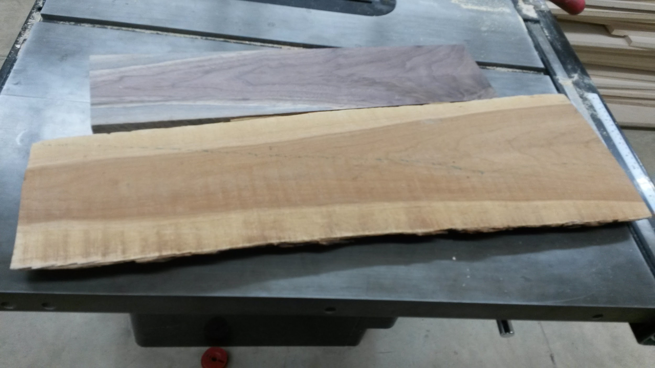
Sapwood vs Heartwood
Sapwood- The living part of the tree- towards the bark
Heartwood- The non-living center
The value of the lumber is dependant on the species
Maple- Value is in Sapwood
Black Walnut, Aromatic Cedar- Value is in Heartwood
Notes:
Left off on Tuesday- 7th hour

Slide 7
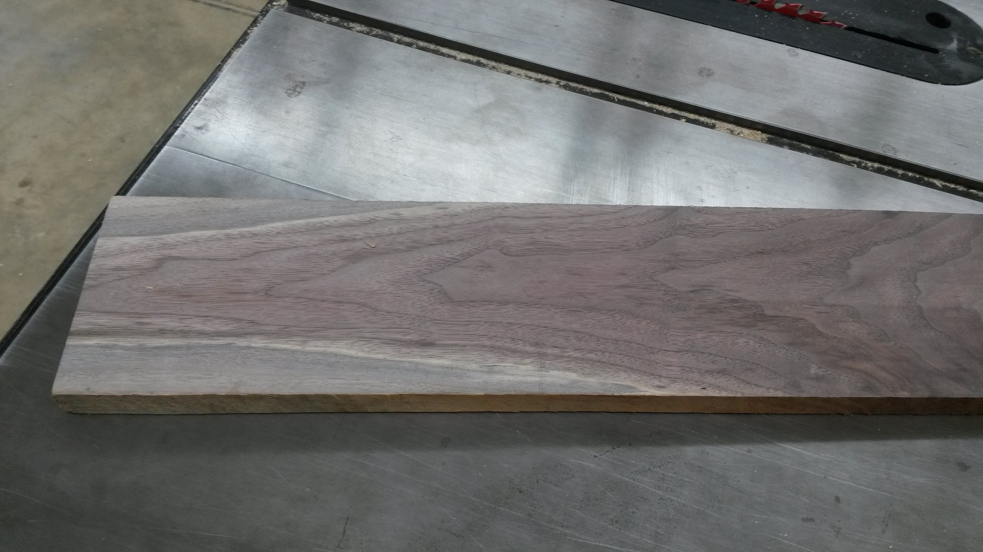
Identify Species
Red Oak/Quarter Sawn- Hard Maple-
Black Walnut- Butternut-
White Pine- Cedar-
Ash- SPF- Spruce, Pine, Fir

Slide 8
Identify Species- Uses
Red Oak- Cabinets, Doors, Trim Hard Maple-Gym Floors, Bowling Alleys, Benches
Black Walnut- Gunstocks Butternut- Furniture, Carving
Cherry- Cabinets, Trim, Furniture White Pine-Cabinets, Trim, Cabinets, Paneling
Cedar- Ext Projects, Paneling Ash- Bats, Benchtops, Handles
SPF- Spruce, Pine, Fir- Construction Lumber

Slide 9
Identify Species- Pros/Cons
Red Oak- Durable, Uniform Used everywhere Hard Maple-Durable Hard to work with
Black Walnut- Color, Shock Absorption Expensive Butternut- Color Wearability
Cherry- Easy to work with, Color Expensive White Pine-Rustic Wearability
Cedar- Weather Durability Wearability Ash- Strong Moisture Resistance
SPF- Spruce, Pine, Fir- Cheap Not for appearance

Slide 10
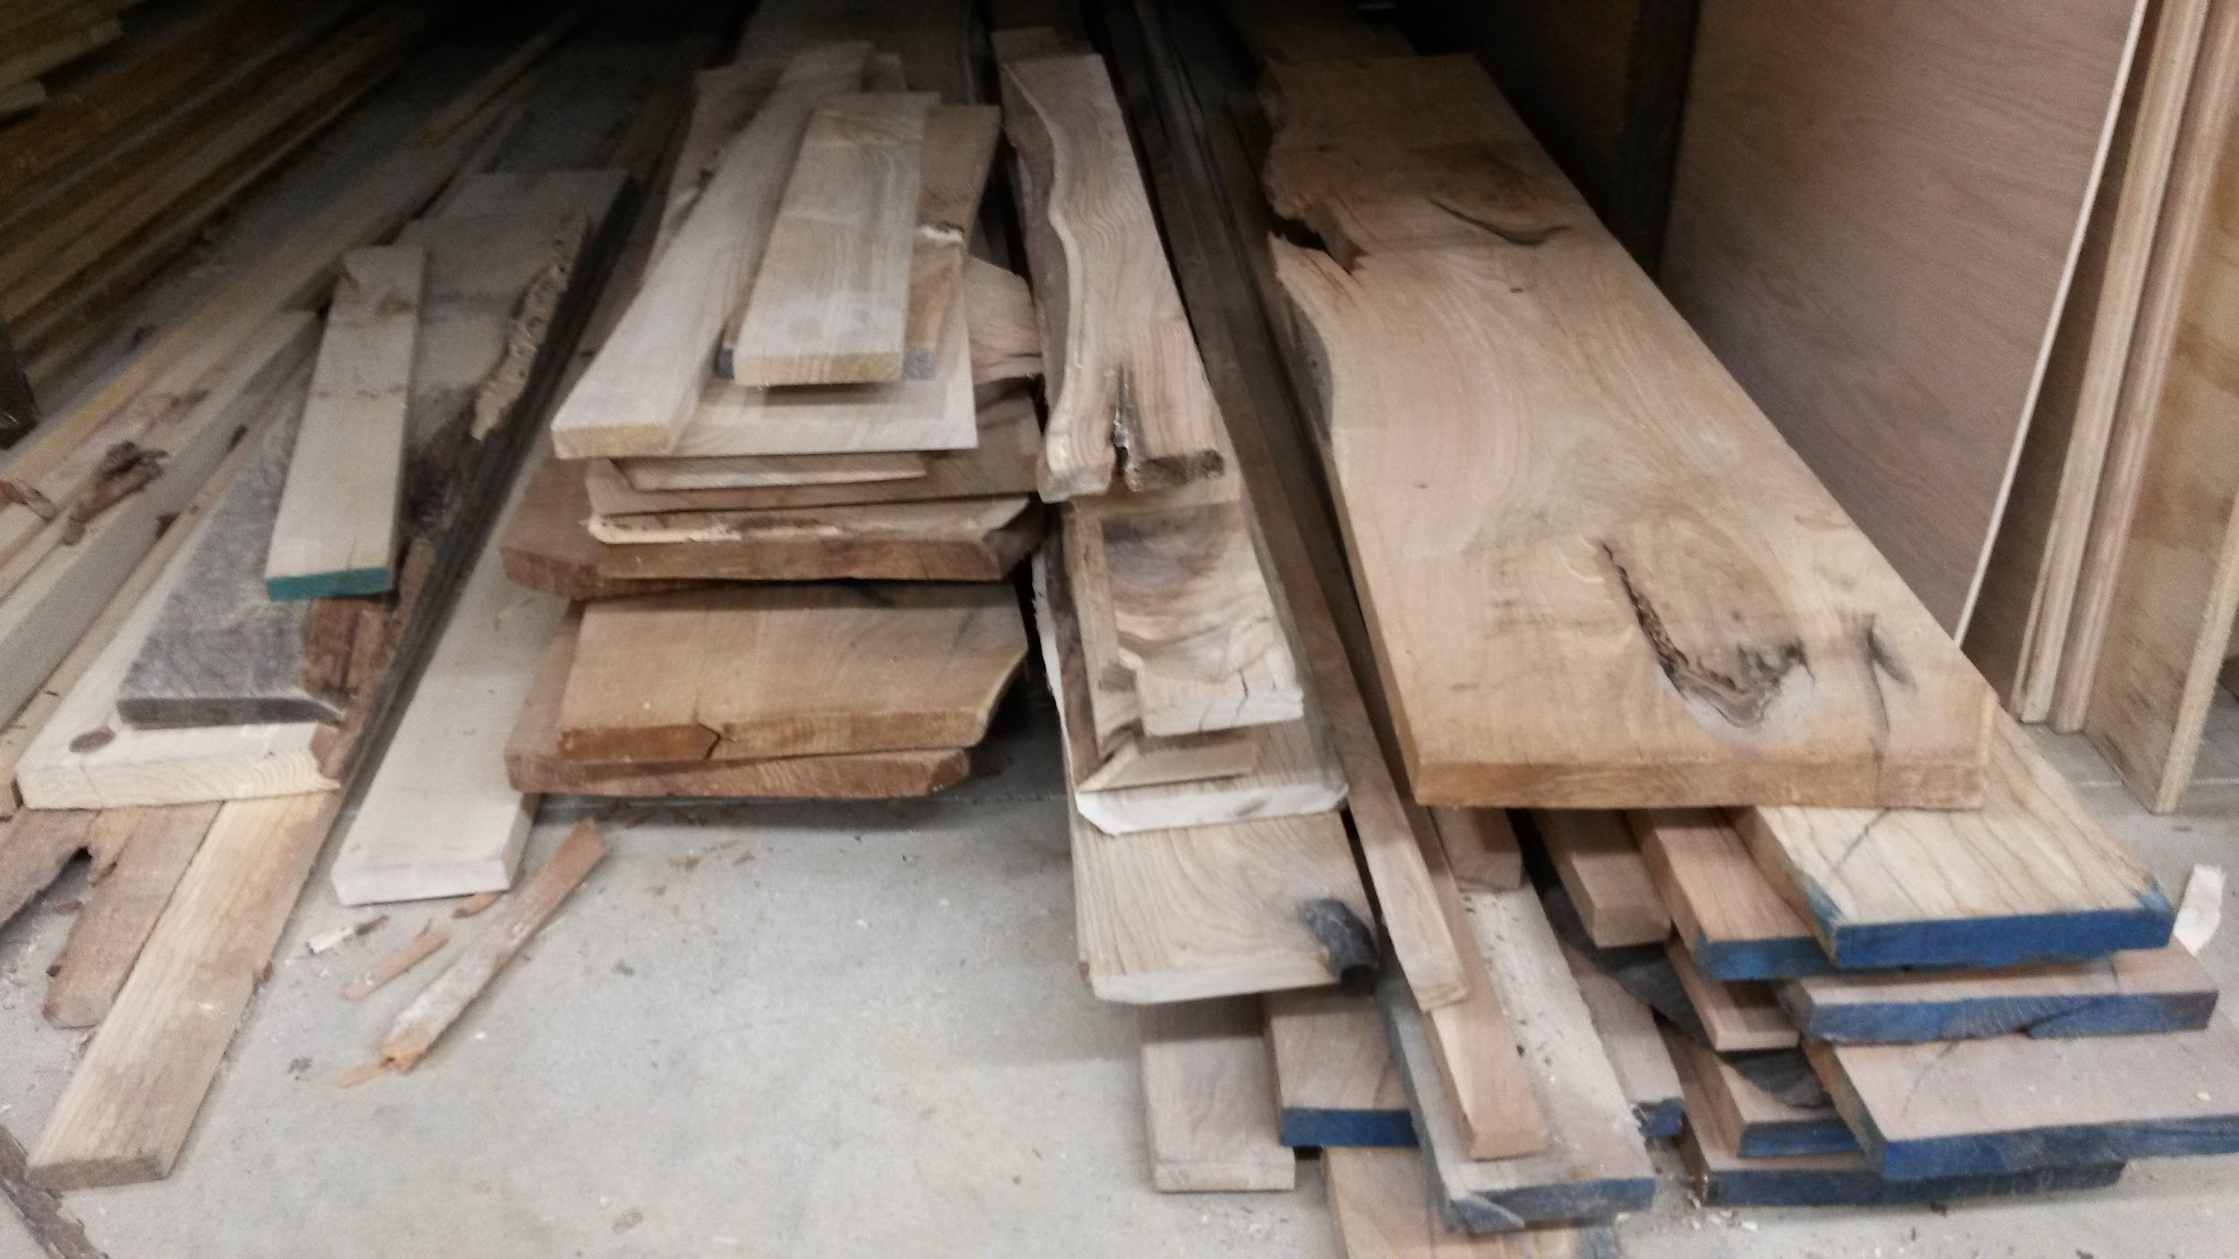
Board Feet- Dimensional Lumber
Board Feet=
When all dimensions are in Inches
Quantity of Boards X Thickness X Length X Width
144

Slide 11
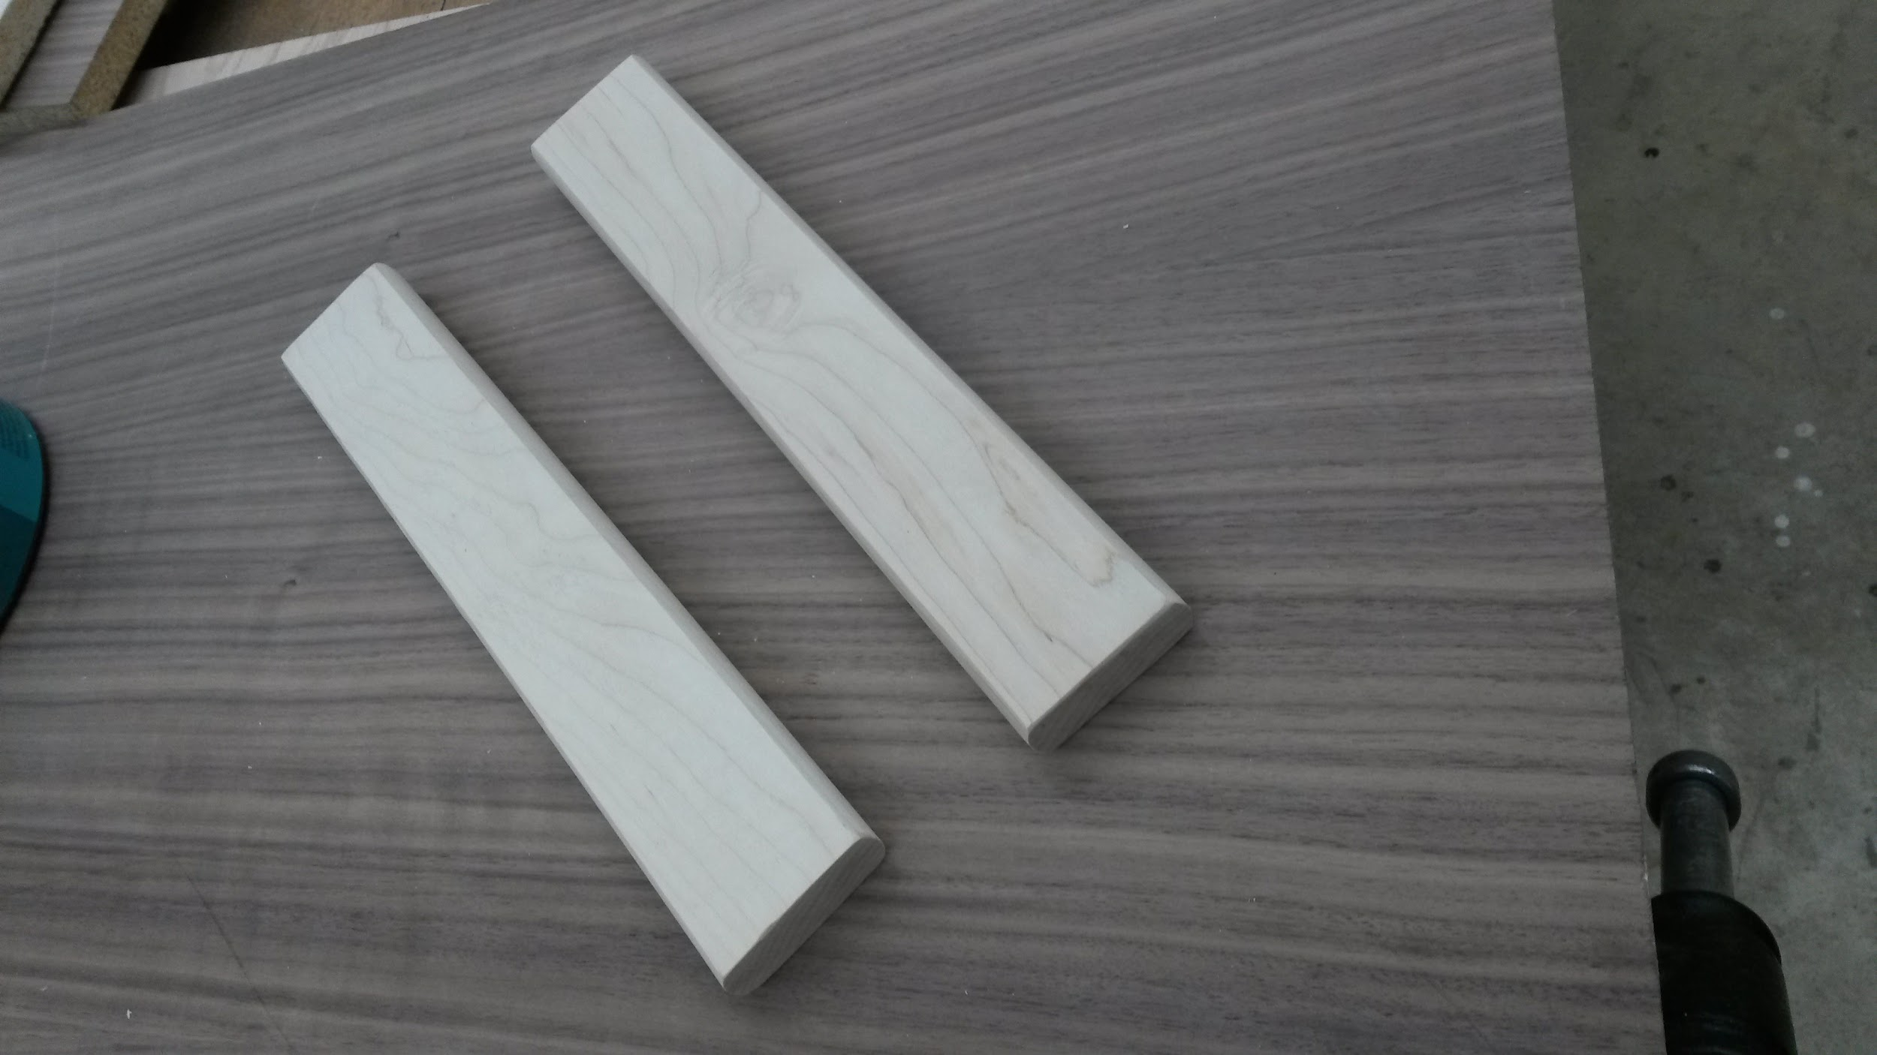
Board Feet
1 board at 1x 1 x 144
2 boards at 1 x 2 x 36
1 board at 2 x 3 x 24

Slide 12
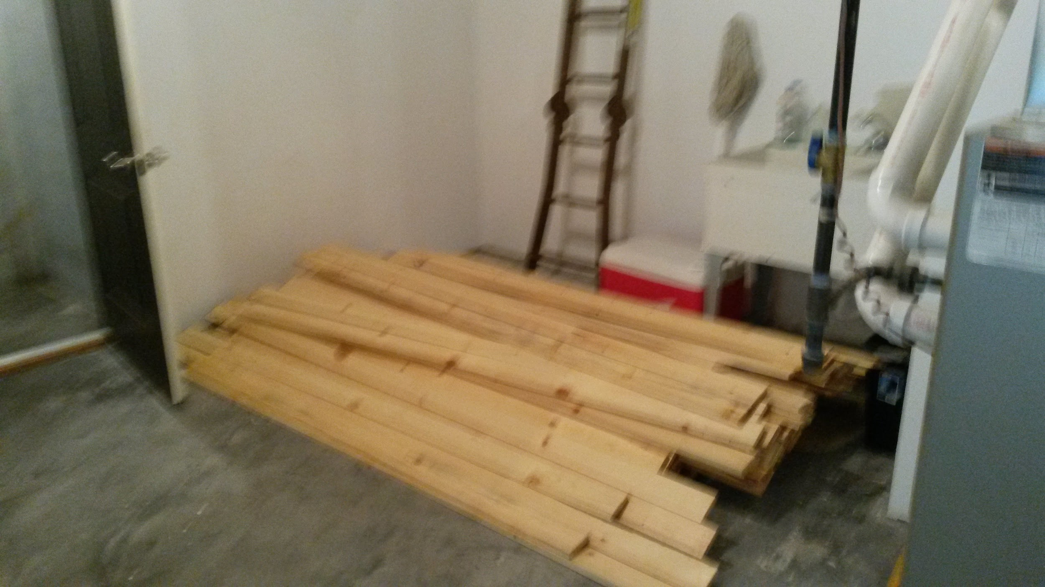
Board Feet- Dimensional Lumber
Board Feet=
When one dimension is in feet Either Length or Width
Quantity of Boards X Thickness X Length X Width
12

Slide 13
Calculating Waste- Board Feet
Make sure thickness is in inches not parts of an inch.
Take board feet total and multiply by .30 for 30% waste
Ex: If you had 7.5 board feet
7.5 X .3 = 2.25 for waste

Slide 14
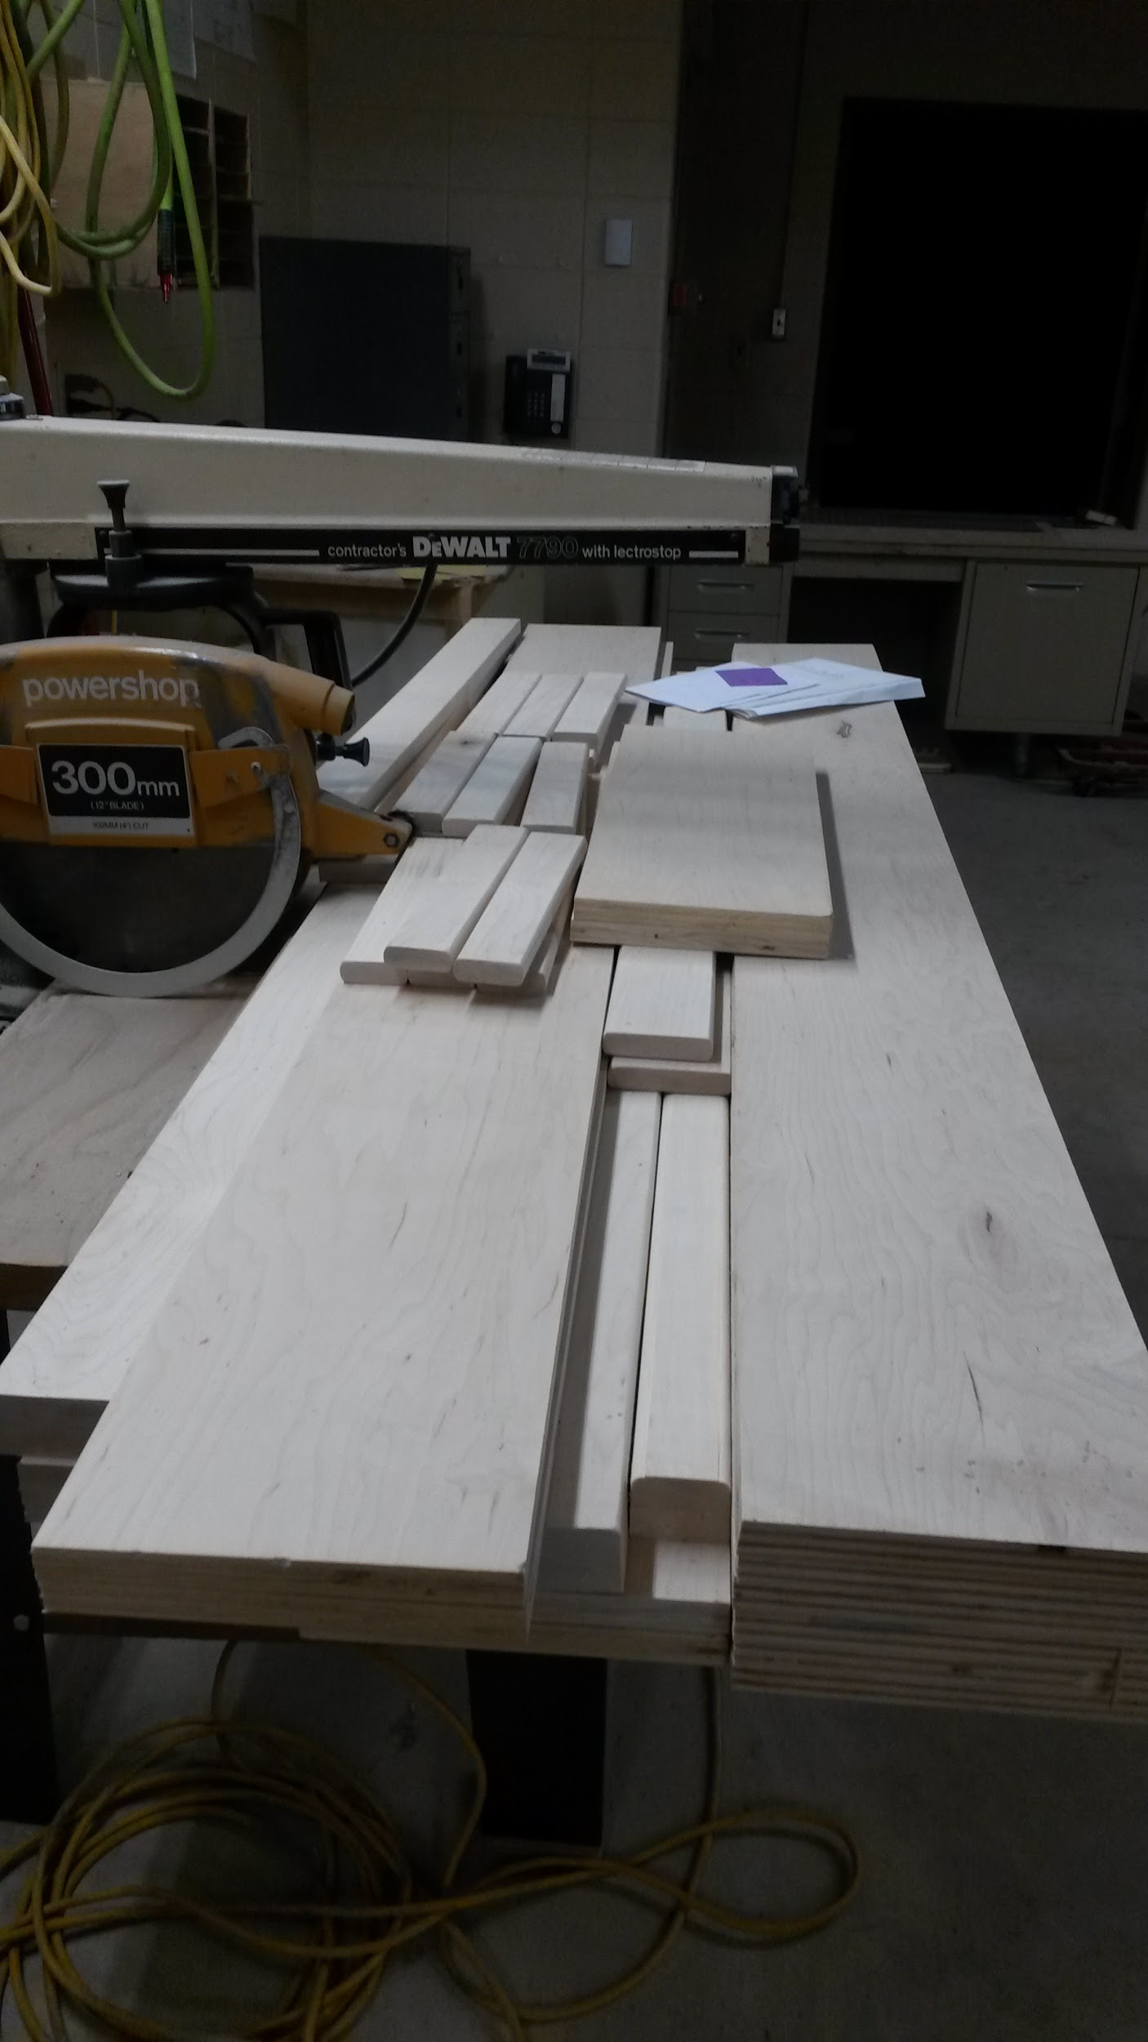
Try Examples on Board
5 boards that are 1” T by 8” W x 48” L =
7 boards that are 3” T by 5” W x 8’ L =
1 board that is 2” T by 4 5/8 ” W x 24” L =
2 boards that are 1” T by 1” W x 7’ L =
8 boards that are 2” T by 3” W x 60 1/4” L =
What is the waste for the above 5 problems?
How much wood would you actually need?

Slide 15
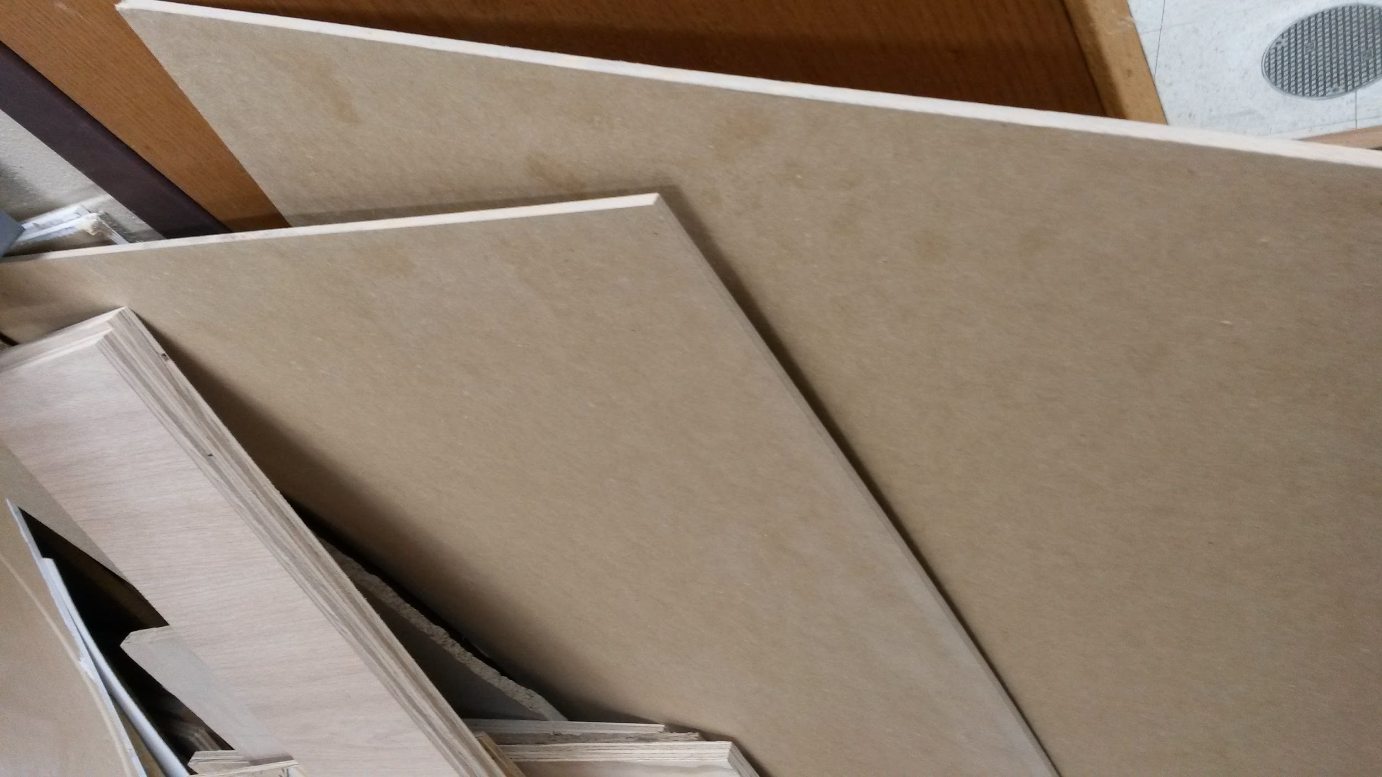
Sheet Material
Veneer
Plywood
MDF
Hardboard
Combi Core or Combination Core
Usually 4’ x 8’

Slide 16
Sheet Material
Plywood- Strong, Holds Nails and Screws
Water resistant
MDF- More Stable, Environmentally Friendly
Routered, Machined Easily, Does not hold nails,
Breaks Easily
Hardboard- Stable, Machines Easily, Finer
Particles than MDF,
Not water resistant, breaks easily

Slide 17
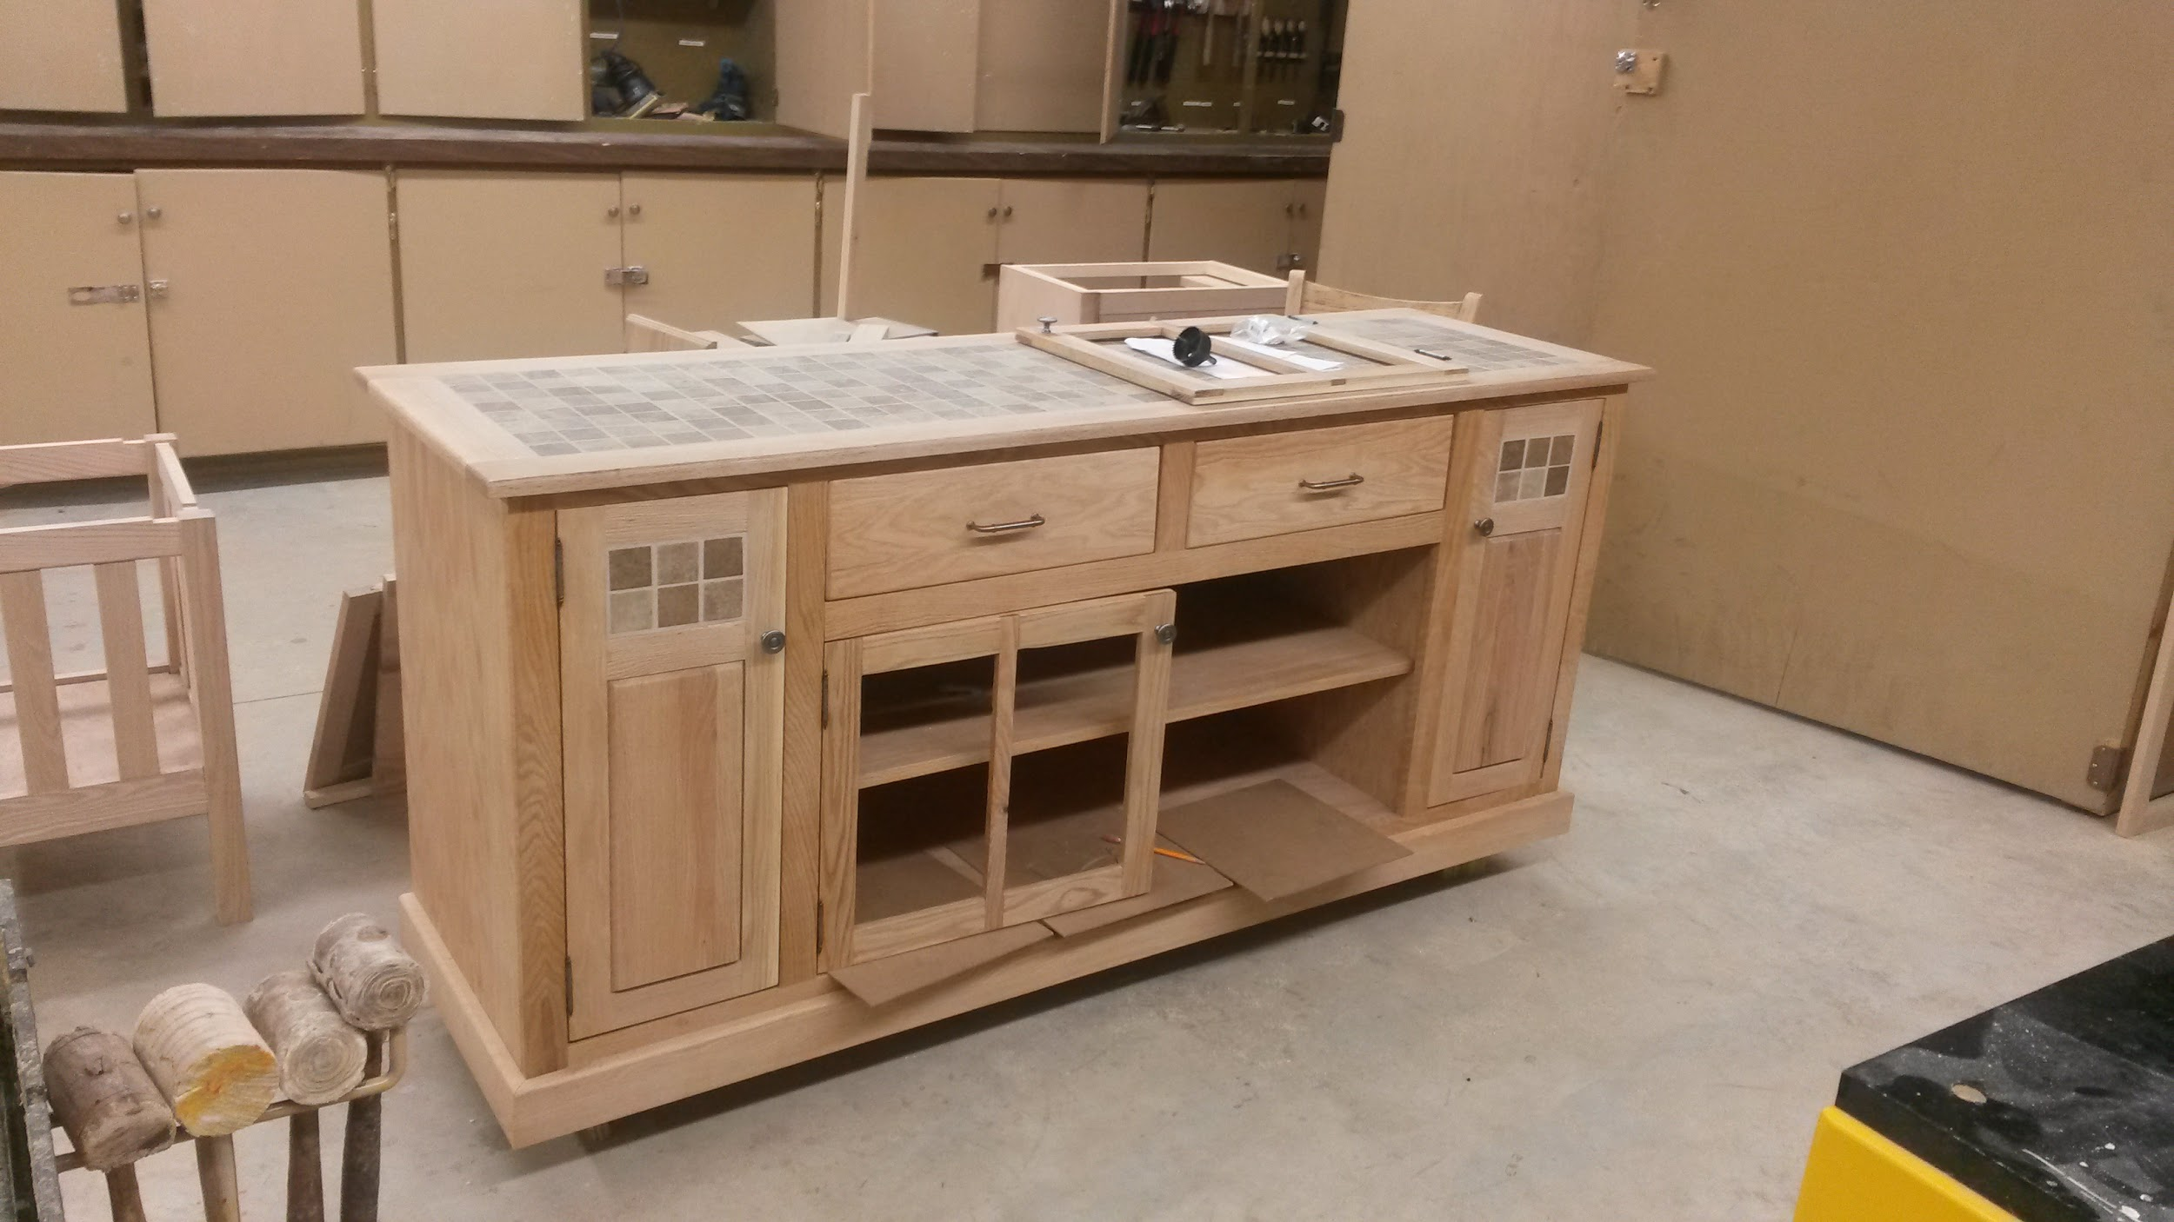
Square Foot- Sheet Stock
Square Feet=
When in Inches we do not use thickness
Quantity of Boards X Length X Width
144

Slide 18
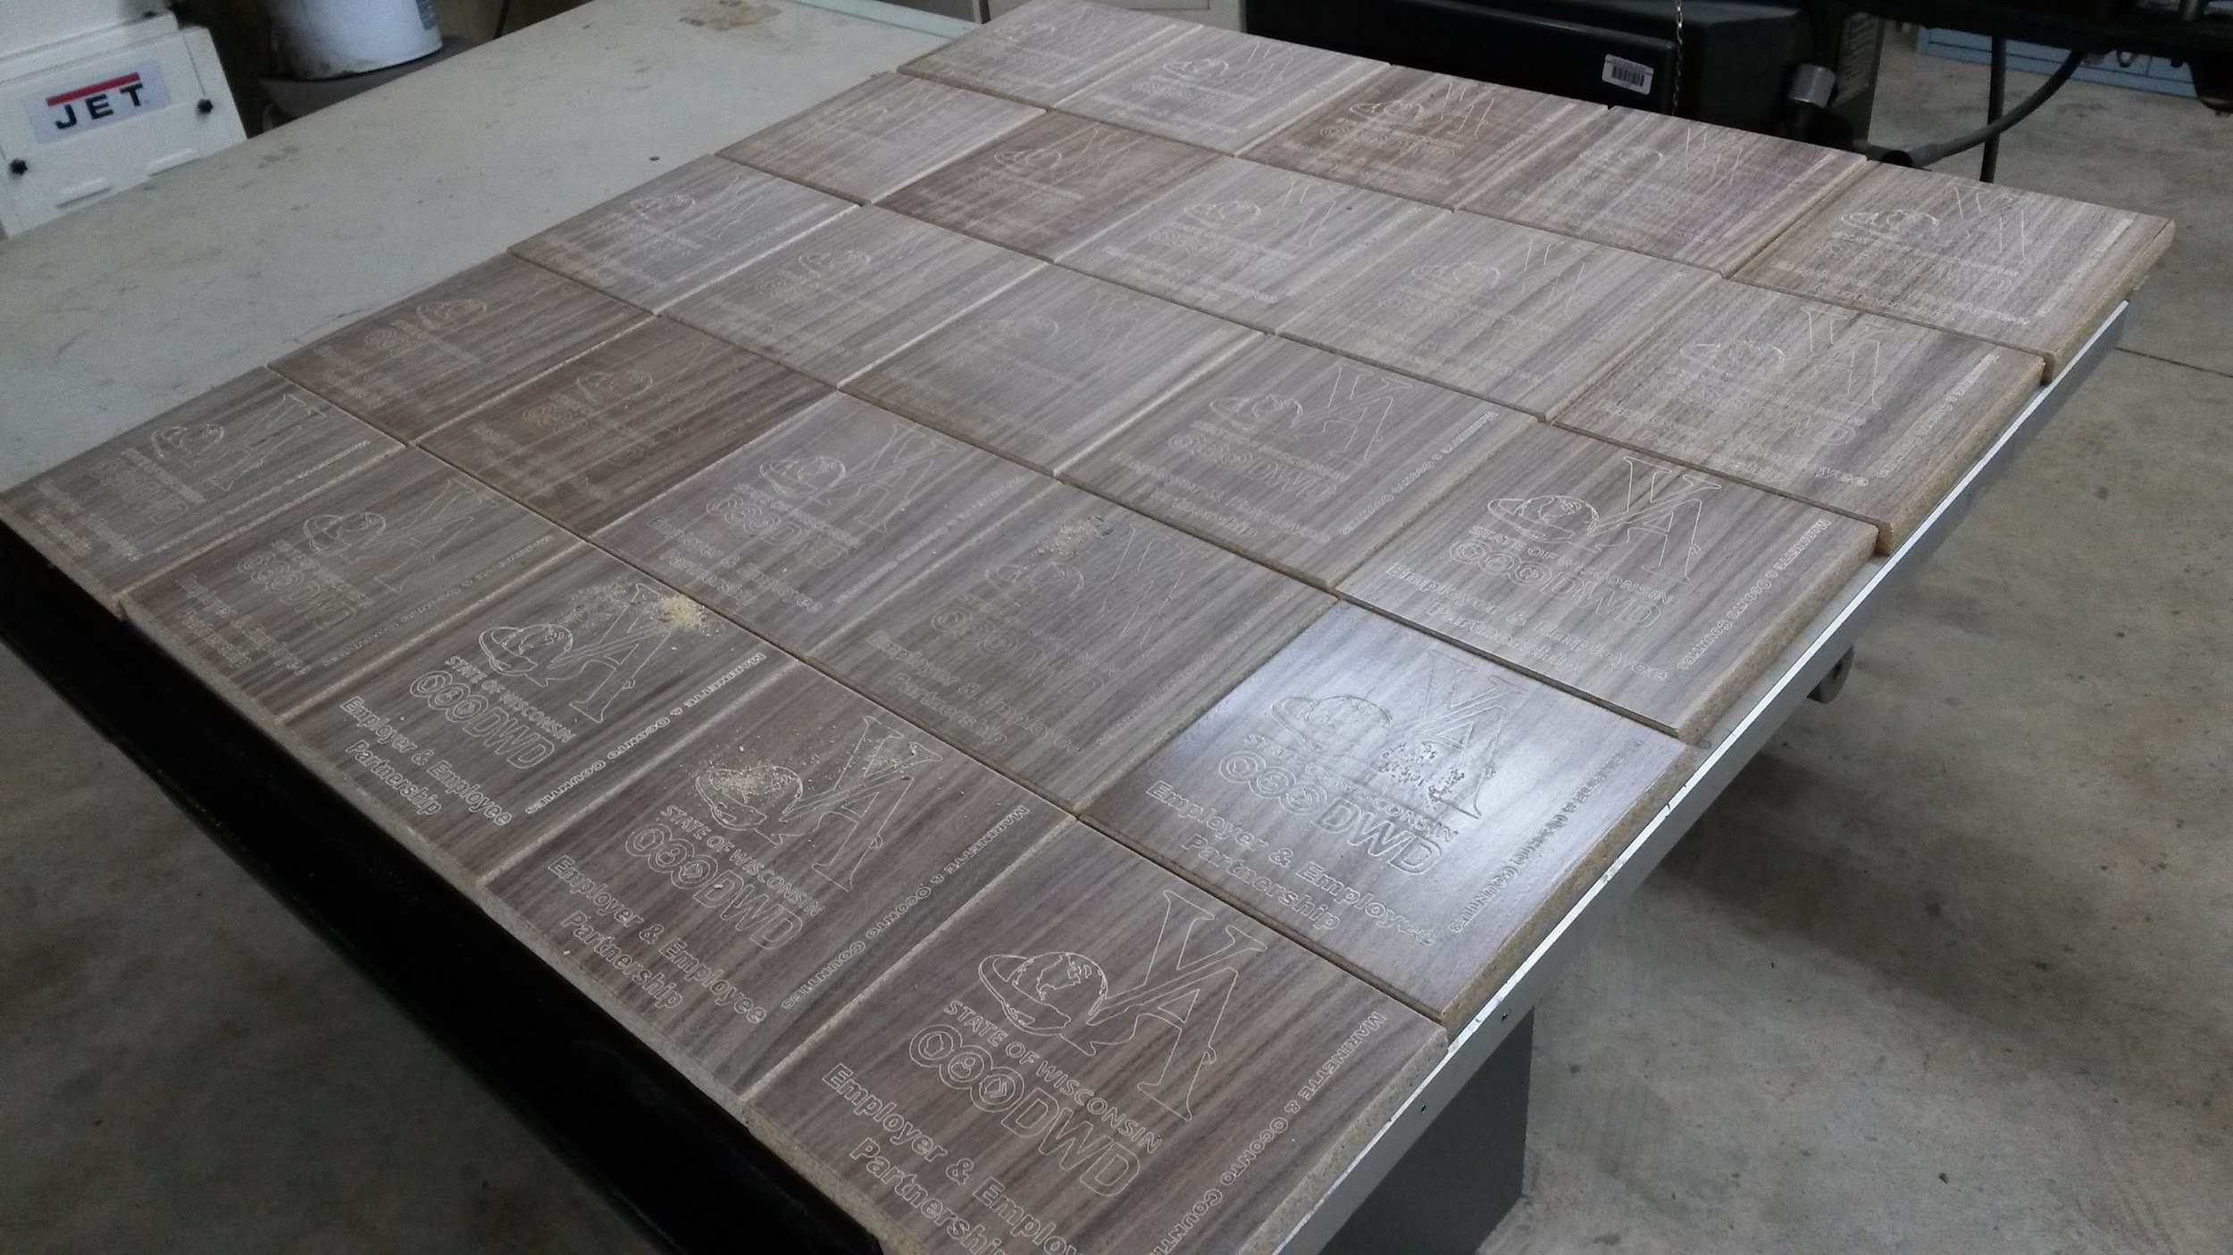
Square Foot- Sheet Stock
Square Feet=
When one dimension is in feet.
Quantity of Boards X Length X Width
12

Slide 19
Square Foot- Sheet Stock
Square Feet=
When in Feet for Both Dimensions
Quantity of Boards X Length X Width
This is more common when working in construction:
Paint, Flooring, Drywall, Roofing, Siding

Slide 20
Square Foot
Estimating by sheet
Layout parts on a piece of paper or on CAD
Figure out how many sheets you need
This is how I estimate

Slide 21
Calculating Waste- Square Feet
Make sure thickness is in inches not parts of an inch.
Take square feet total and multiply by .30 for 30% waste
Ex: If you had 12 square feet
12 X .3 = 3.6 sq/ft for waste

Slide 22
Practice
2 boards that are 23 1/4” W x 32 1/2” L =
3 boards that are 9” W x 6’ L =
4 boards that are 8” W x 24” L =
1 board that is 12” W x 54” L =
2 boards that are 16 3/8” W x 3’ L =
3 boards that are 2’ x 3’ =
What is the waste for the above 5 problems?
How much wood would you actually need?

Slide 23
Trim
Casing- Doors and windows
Base - Floor
Crown- Ceiling
Chair rail- On middle of wall

Slide 24
Linear Feet
Thickness and width does not matter… Only Length
Measure amount of feet needed. Be sure to add in for corners
When repeating get one length the figure out O.C. and multiply

Slide 25
Calculating Waste - Linear Feet
Thickness and width does not matter… Only Length
Take linear feet total and multiply by .10 for 10% waste
Ex: If you had 10 linear feet
10 X .1 = 1 foot for waste

Slide 26
Practice Calculate- Linear Feet
We have a room that is 12’ x 16’ and has (1)
3’ door. How much base do I need
We have (18) doors and all need to be cased on
both sides. Average door is 3’ x 6’-8” Trim is 3” wide.
A room is 18’ x 16’ How much Crown molding do you need?

Slide 27
Fasteners
Glue
Screws
Nails
Biscuits
Dowels

Slide 28
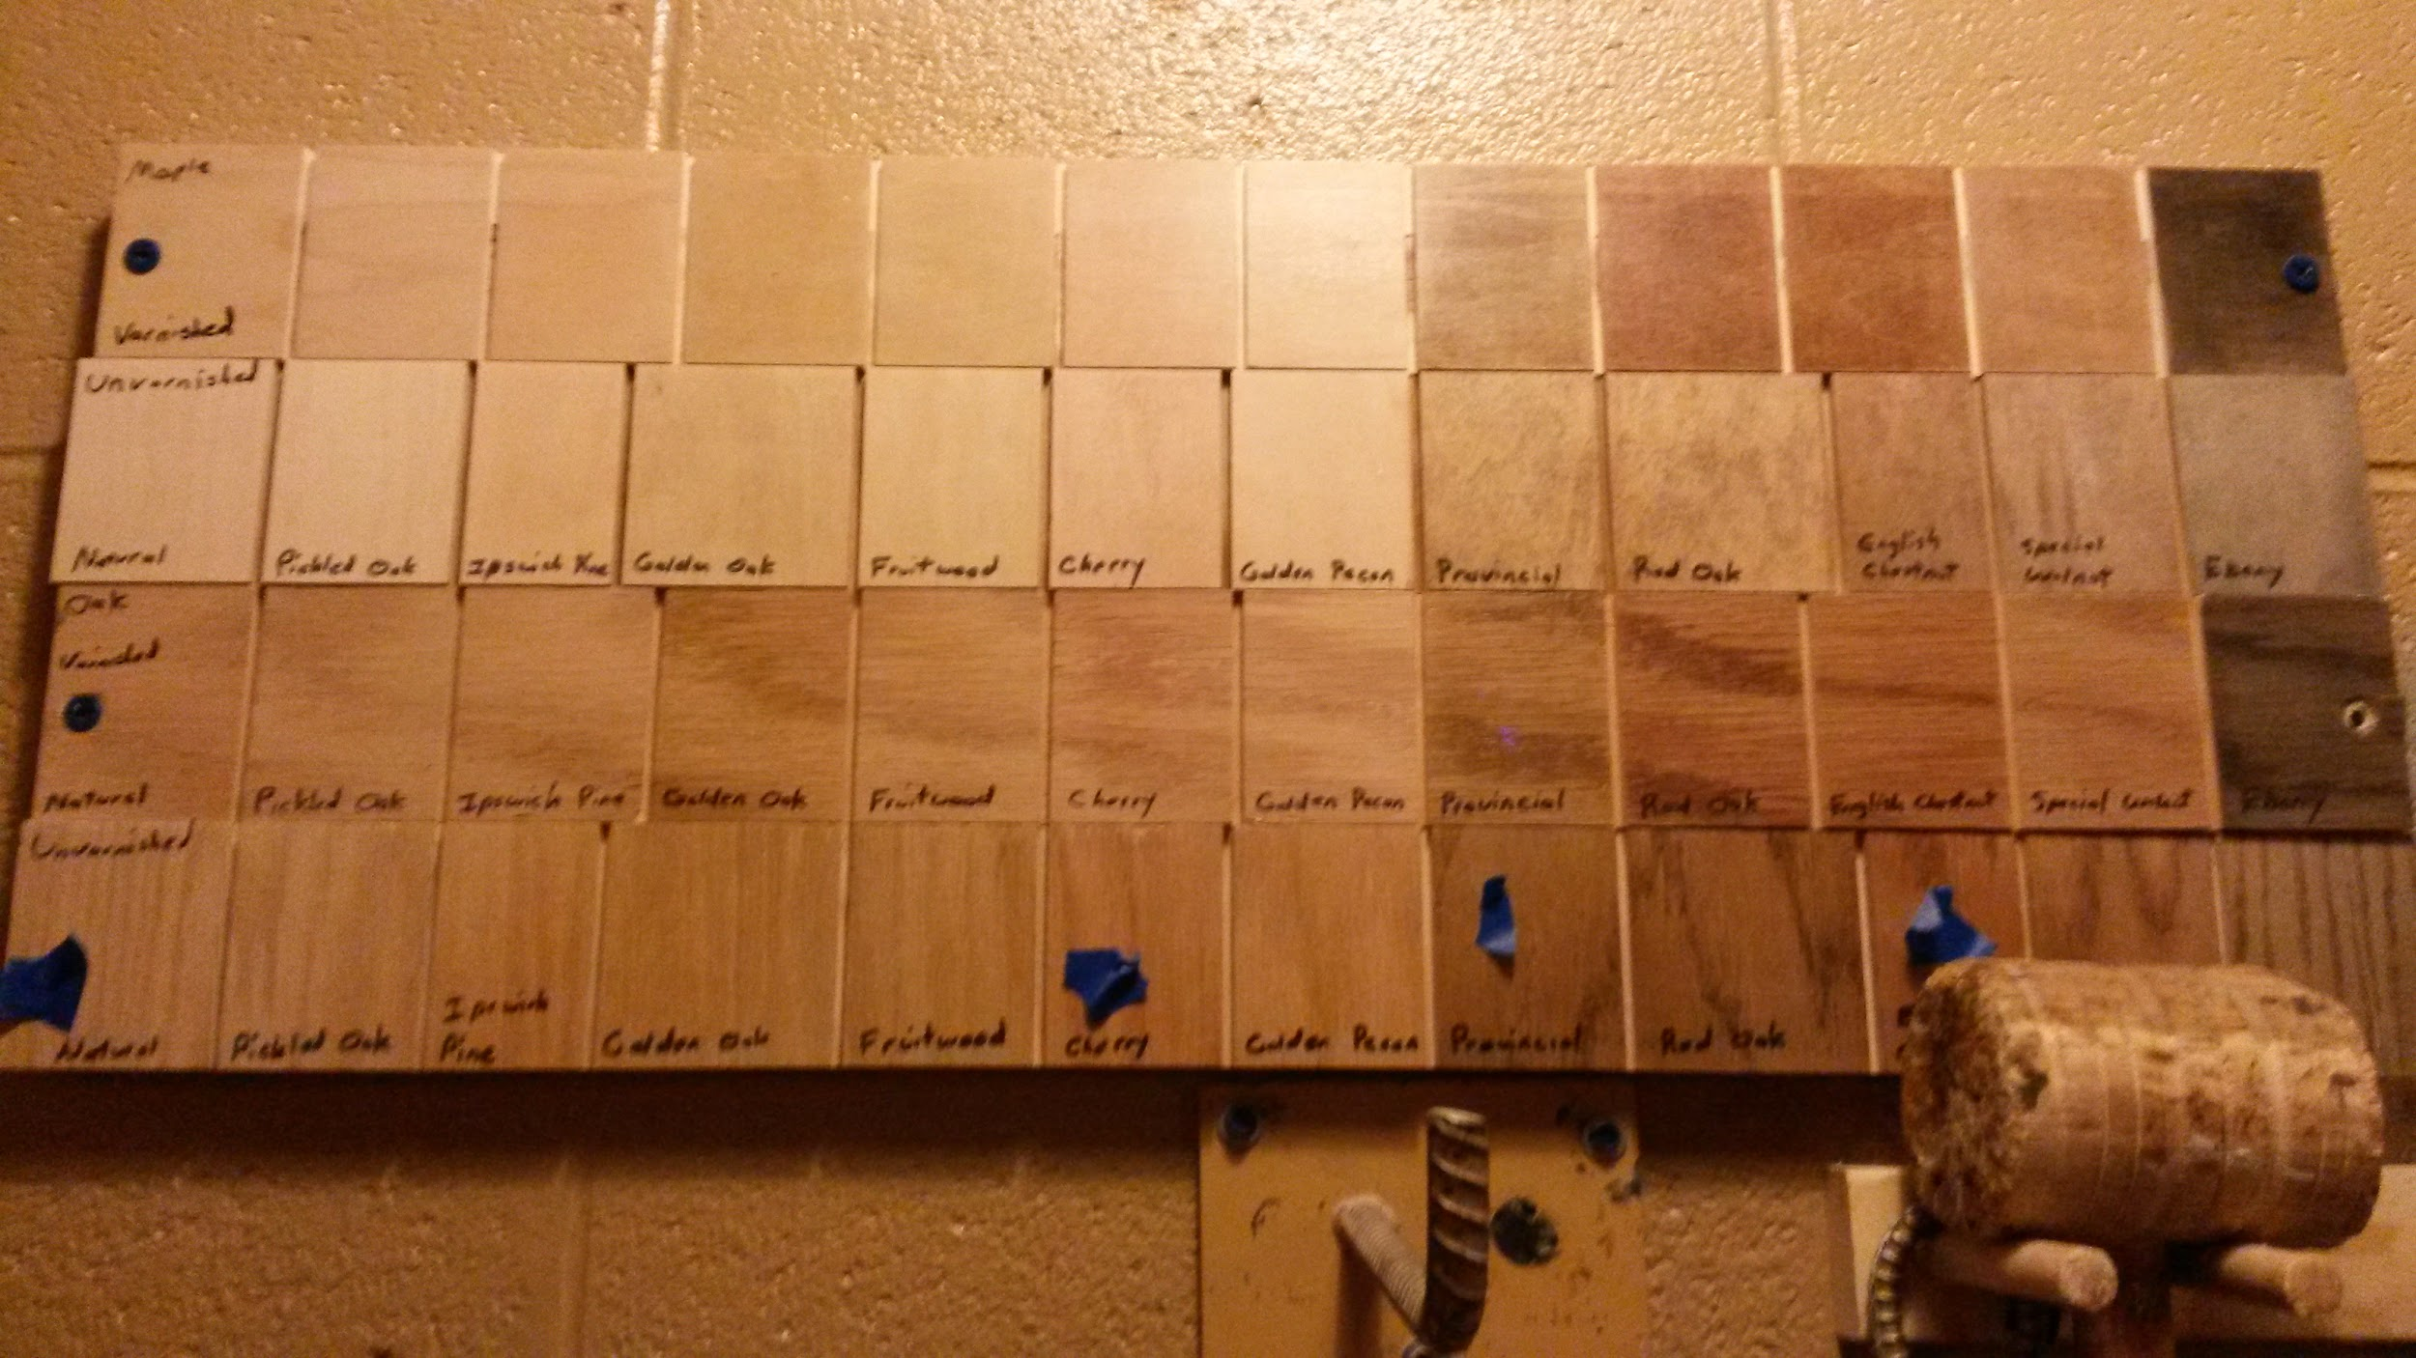
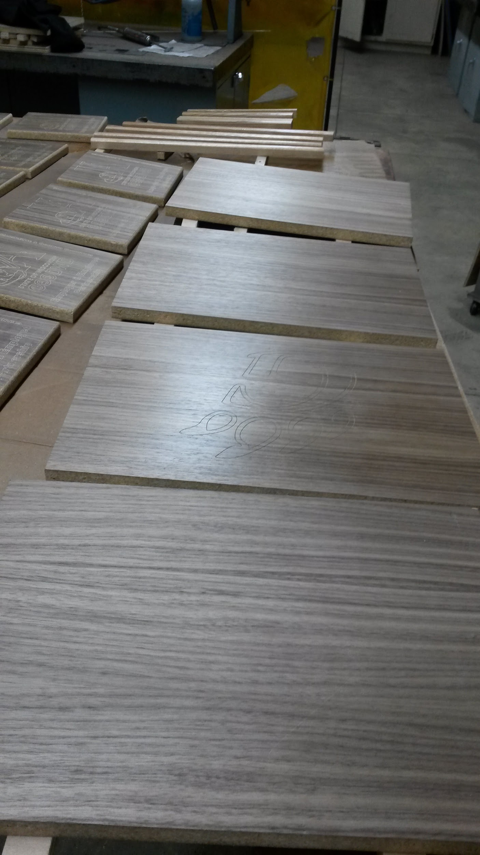
Finish
Stain
Varnish
Take total footage and multiply by 2.
Figure on finishing both faces
Cost per sq/ft depends on finish

Slide 29
Hardware
For each door: Minimum (2) Hinges and (1) Handle
For each drawer: (2) Drawer Guides and (1) Handle

Slide 30
Putting it all together
Sometimes you will use one or all of the methods.
Key is a good drawing/plan for the project.

Slide 31
Review
What is the formula for Board feet and where do we use it?
What is the formula for Square Feet and where do we use it?
What is the formula for Linear Feet and where do we use it?

Slide 32
Questions?

Slide 33
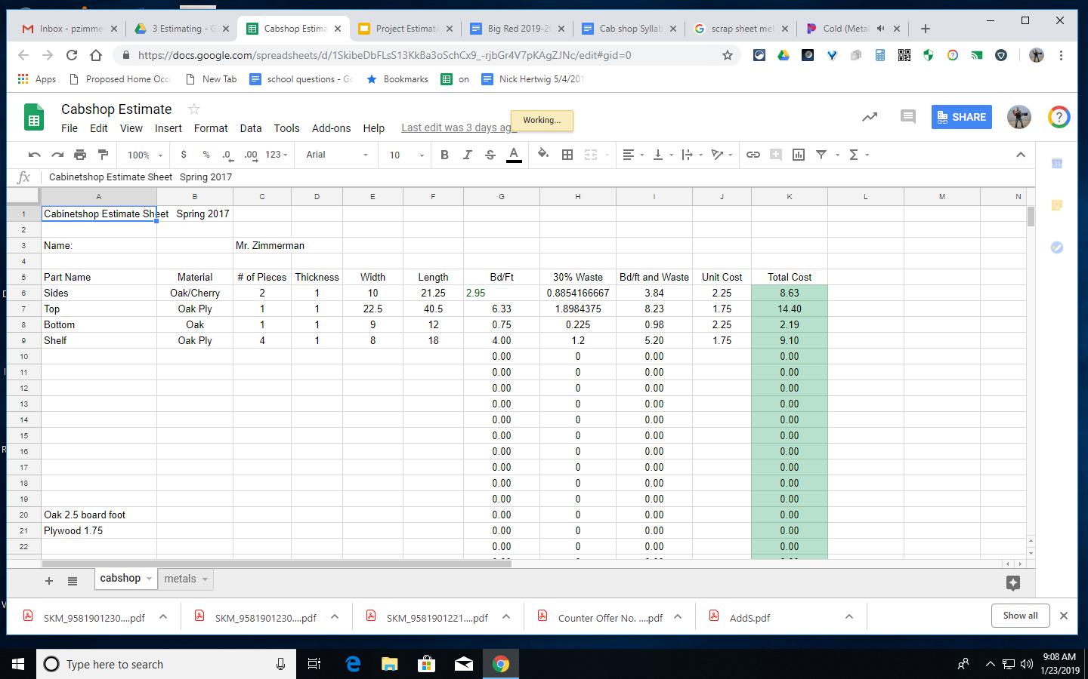
Spreadsheet Development

