Slide 1
INTRODUCTION TO ENTREPRENEURSHIP BUSINESS PLANNING

Slide 2
WHAT’S A BUSINESS CONCEPT?
Business Concept:
Focuses the idea by answering the question of “what” your business is.

Slide 3
BUSINESS CONCEPT VS. BUSINESS MODEL
Business Concept:
Focuses the idea by answering the question of “what” your business is.
Business Model:
Describes the rationale of how an organization creates, delivers, and captures value.

Slide 4
BUSINESS CONCEPT VS. BUSINESS MODEL
Business Model:
Describes the rationale of how an organization creates, delivers, and captures value.
How will you make money?

Slide 5
PLANNING TO FAIL
Traditional startup model is to write a business plan, then execute the plan

Slide 6
PLANNING TO FAIL
Traditional startup model is to write a business plan, then execute the plan
“No business plan ever survives its first contact with customers”
- Steve Blank
Startups need to search for a business model rather than execute a business plan

Slide 7
TRADITIONAL MODEL FOR PLANNING A STARTUP
Entrepreneur gets an idea
Entrepreneur builds their idea
Entrepreneur brands their idea
Entrepreneurs goes looking for customers

Slide 8
HOW THIS MODEL LOOKS
IDEA
BUILD
BRAND
CUSTOMER

Slide 9
HOW THIS MODEL LOOKS
IDEA
BUILD
BRAND
CUSTOMER
Startup Loop of Despair

Slide 10
STARTUP LOOP OF DESPAIR
Can last anywhere from a few months to a few years
Sometimes there is no fix and business fails
Can be avoided
IDEA
BUILD
BRAND
CUSTOMER

Slide 11
EVIDENCE-BASED ENTREPRENEURSHIP
Potential customers hold all the answers
Get out of the building and talk to them
Find out what features and benefits are most valuable
Build your product/service based on what you learn

Slide 12
EVIDENCE-BASED ENTREPRENEURSHIP
Potential customers hold all the answers
Get out of the building and talk to them
Find out what features and benefits are most valuable
Build your product/service based on what you learn
IDEA
CUSTOMER
BUILD
BRAND

Slide 13
UNDERSTANDING THE BUSINESS MODEL
The term “business model” can mean:
The activities or tasks a business undertakes
A blueprint for running a business
Business model reflects the strategic decisions and trade-offs that entrepreneurs make to earn profit
A successful venture creates value by differentiating itself from competitors and/or by meeting an unserved need in the market

Slide 14
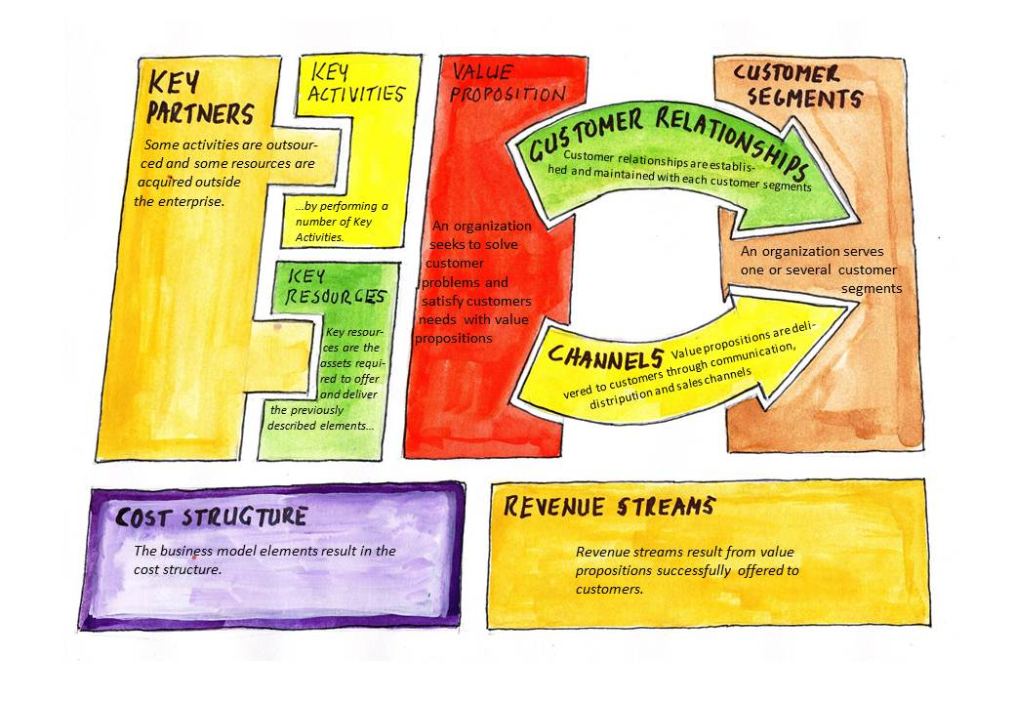
THE NINE BUILDING BLOCKS
A Business Model entails nine (9) basic building blocks that show how a business intends to make money
Building blocks cover the four main areas of a business:
Customers
Offer
Infrastructure
Financial Viability

Slide 15
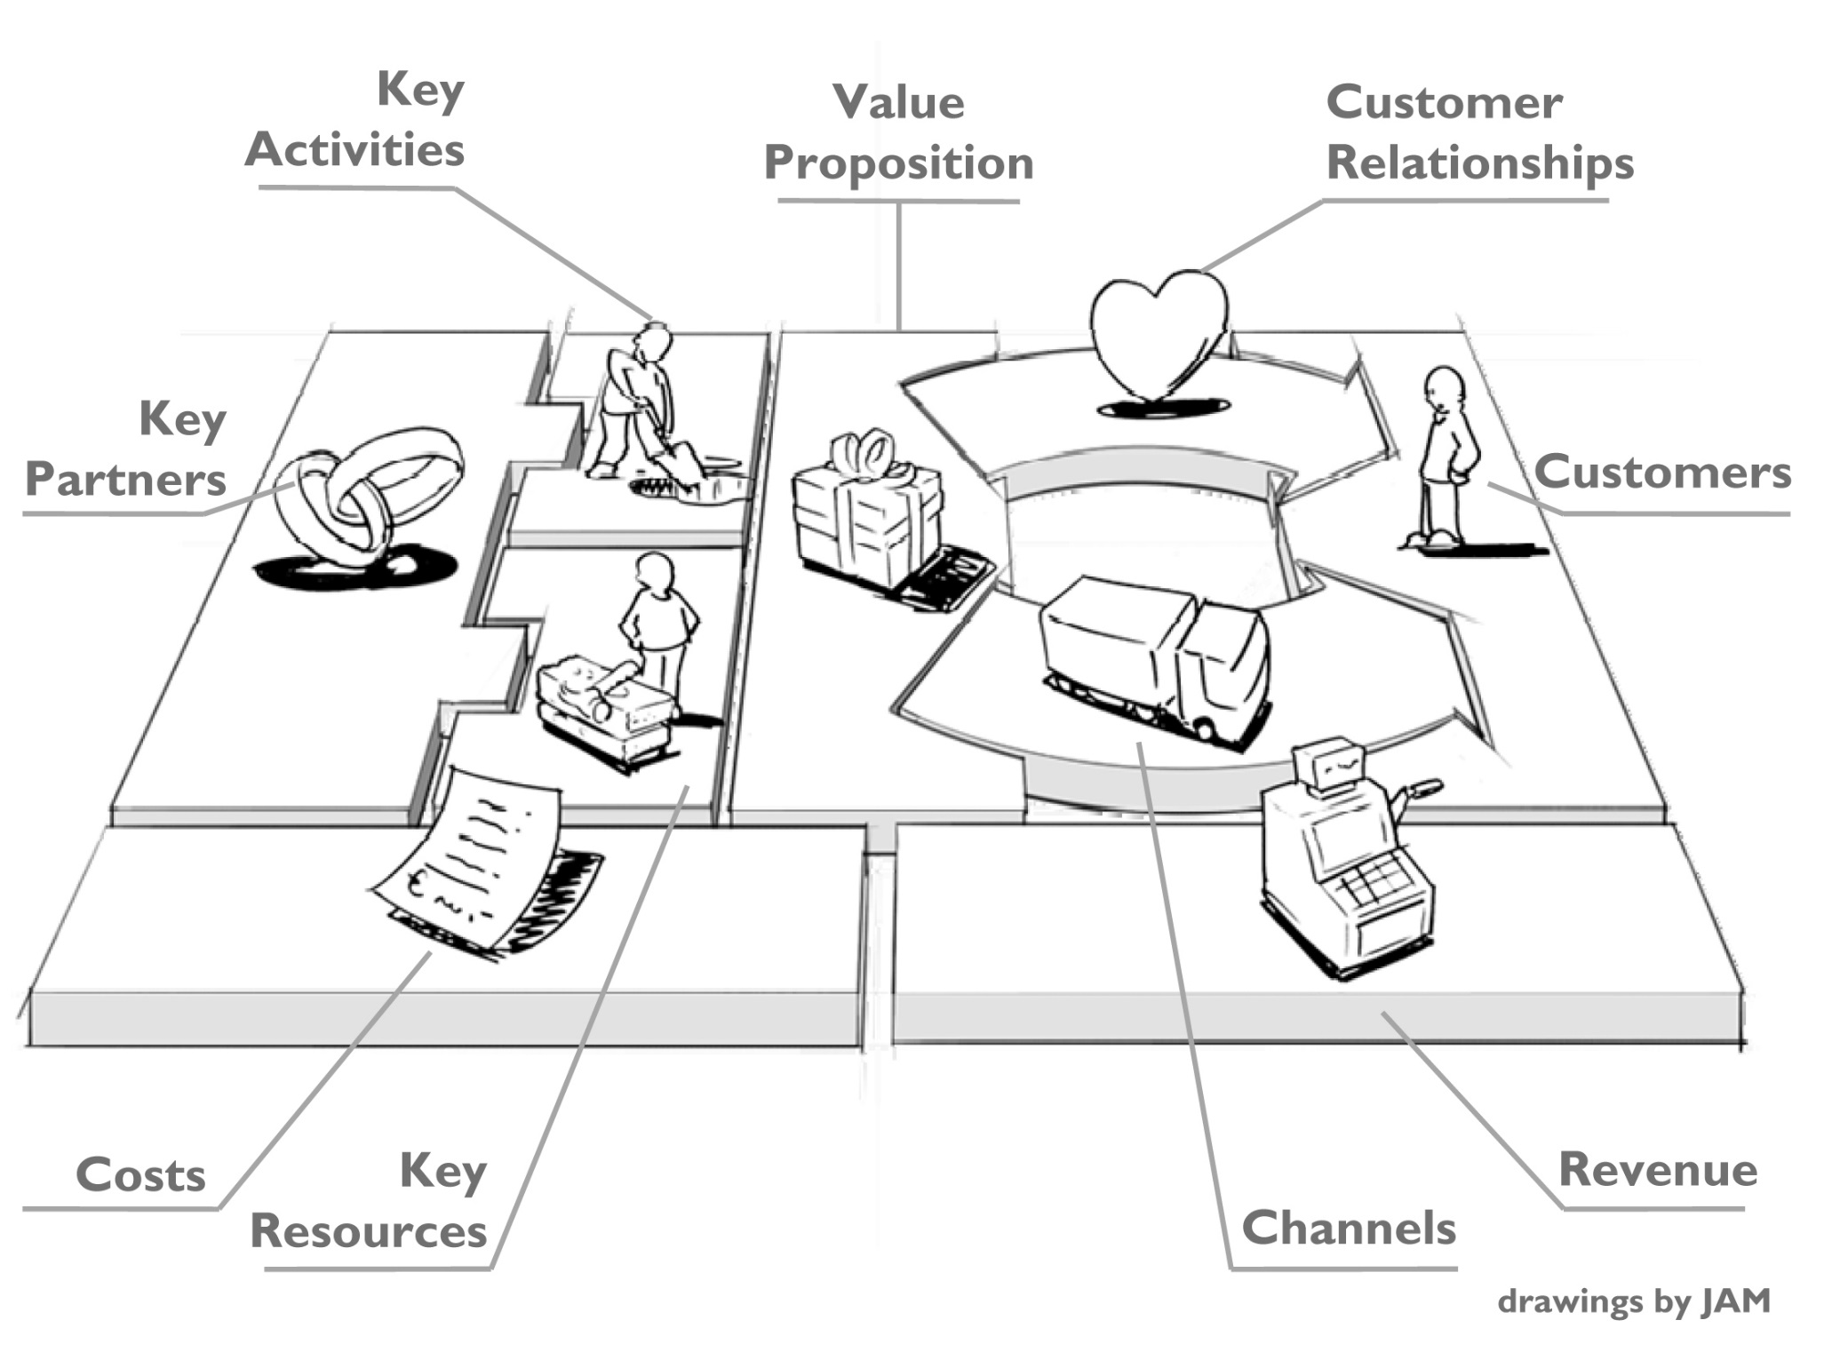
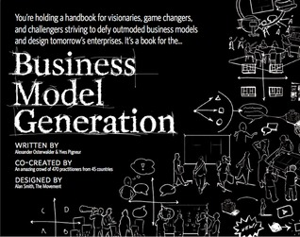
Business Model Canvas©
Alexander Osterwalder

Slide 16
VALUE PROPOSITION
Benefit that the customer derives from the product or service you are offering
Unique mix of product, price, service, relation, and image that a company offers to a group of targeted clients
Don’t confuse features with benefits

Slide 17
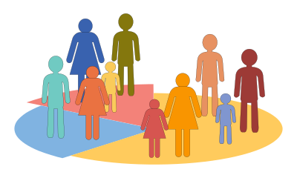
CUSTOMER SEGMENTS
Who is the customer?
What are their characteristics or attributes?
Beware … the “customer” might not be the actual user of the product or service

Slide 18
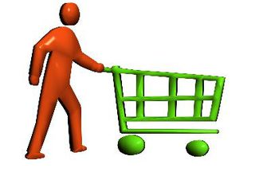
DISTRIBUTION CHANNELS
Answers the question “How do you deliver the benefit to the customer?”
Many options, but the best one fulfills customer’s expectations about where and how they want to purchase
Most services delivered direct to customers, but products often go through channel intermediaries (distributors and retailers)

Slide 19
STRATEGIC PARTNERS
Common today for startups to partner with existing companies to tap into other expertise and resources
Example: Buyer-supplier relationship used to reduce costs or share facilities like manufacturing or warehousing
Partnerships may involve competitors sharing resources in one area while competing in another
Some partnerships involve licensing intellectual property rather than developing it in-house

Slide 20
KEY BUSINESS ACTIVITIES
Key business activities could involve manufacturing, distribution, R&D, technology, platform, etc.
Each type of business has different functions and unique resource requirements critical to delivering Value Proposition
Resources include human, physical, intellectual and capital

Slide 21
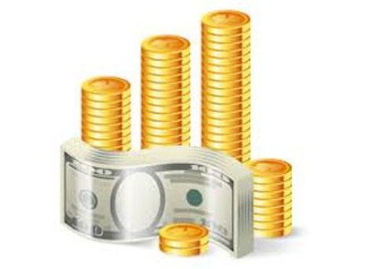
REVENUE SOURCES
Important component of Business Model is to identify revenue streams:
Subscription or membership
Volume or unit-based
Licensing and syndication
Transaction fee
Advertising

Slide 22
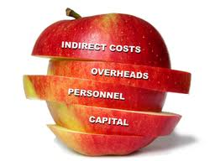
COST DRIVERS
Equally important are expenses and cost drivers:
Marketing or advertising cost structure
Inventory cost structure
Office or retail space cost structure
Support center cost structure
Direct cost structure

Slide 23
QUESTIONS???

Slide 24
LAW OF MARKET FAILURE
Most new ideas fail even if they are very well executed. Statistically the probability of success at launch is approximately 60%.
When it comes to market law we should presume a potential new product will fail (until we’ve collected enough evidence to convince us otherwise).

Slide 25
MINIMUM VIABLE PRODUCT (MVP)
Smallest group of features that will work as a stand alone product/service while still solving the “core” problem.
The MVP helps us:
Eliminate time spent adding more features that in reality won’t equal more sales (i.e. over-engineering)
Expedites getting our product/service in front of the customer
Generates maximum learning in the shortest amount of time

Slide 26
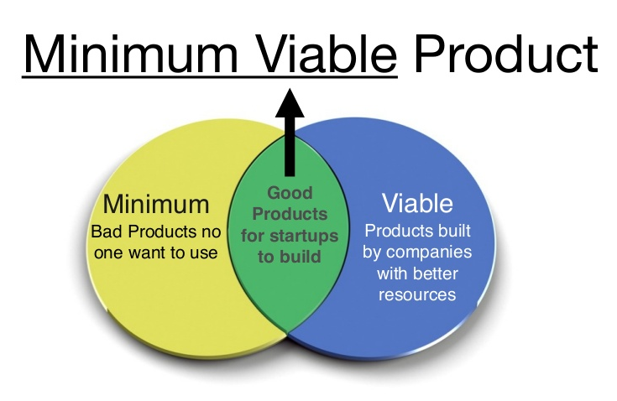

Slide 28
BUILDING A MINIMUM VIABLE PRODUCT (MVP)
An MVP contains enough functionality and value proposition to attract early adopters
Provides feedback and helps develop a final solution for the mass market
Can be represented as either a product or a service
Necessary for Customer Experiments

Slide 29
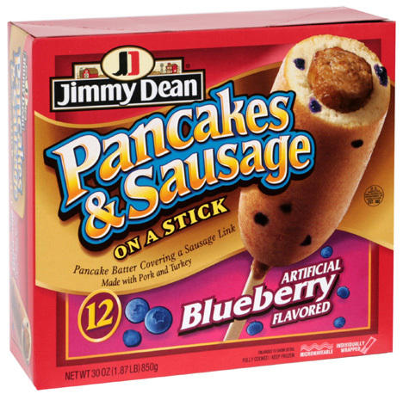
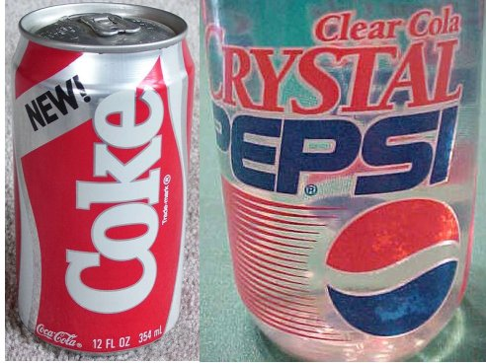
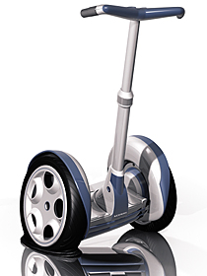
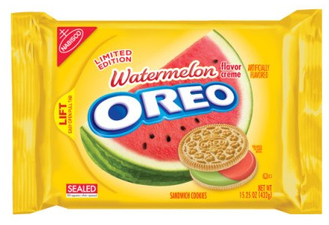
SOME NOTABLE PRODUCT FAILURES

Slide 30
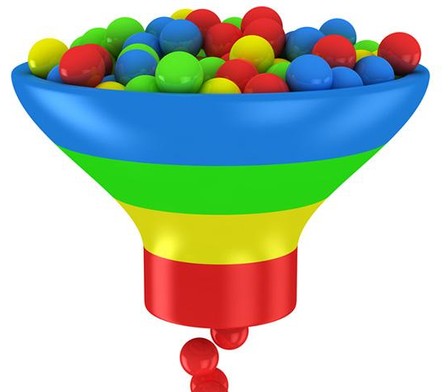
PRODUCT DEVELOPMENT CYCLE
Entrepreneurs who develop products can have more “steps” in the process than service business
Product Development Cycle consists of a series of tasks which appear linear but are not
Customer identification or discovery
Customer validation and design
Business creation

Slide 32
WHY NEW PRODUCTS FAIL
New product failure can be attributed to one or more of three main causes:
Failure in Launch, Operations or Premise
F.L.O.P.

Slide 33
FAILURE IN LAUNCH
Products were well thought-out, met a product need, had the right features, and were properly designed, engineered, and manufactured.
Timing, pricing, or positioning did not create buzz or product traction.

Slide 34
FAILURE IN LAUNCH
Products were well thought-out, met a product need, had the right features, and were properly designed, engineered, and manufactured.
Timing, pricing, or positioning did not create buzz or product traction.
FAILED
We built the right product. We built it right. But we launched it wrong.

Slide 35
FAILURE IN OPERATIONS
Products were well thought-out, met a market need, had the right features and design, and launched successfully.
Operational problems (reliability, usability, performance, etc.) soon followed and Early Adopters questioned product quality leading to poor reviews.

Slide 36
FAILURE IN OPERATIONS
Products were well thought-out, met a market need, had the right features and design, and launched successfully.
Operational problems (reliability, usability, performance, etc.) soon followed and Early Adopters questioned product quality leading to poor reviews.
FAILED
We built the right product. We launched it right. But we built it wrong.

Slide 37
FAILURE IN PREMISE
Products were built well (solid, reliable, stable), had a great launch with lots of buzz and even strong initial sales and adoption.
After a while people realized that they didn’t really need or want it after all.

Slide 38
FAILURE IN PREMISE
Products were built well (solid, reliable, stable), had a great launch with lots of buzz and even strong initial sales and adoption.
After a while people realized that they didn’t really need or want it after all.
FAILED
We built the wrong product to start with.

Slide 39
QUESTIONS???

Slide 40
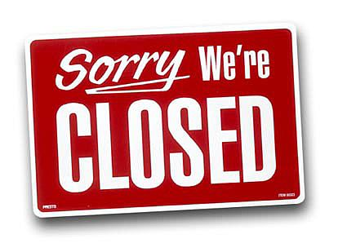
WHY BUSINESS MODELS FAIL
Four major reasons for failure:
Flawed logic
Limited strategic choices
Imperfect value creation
Incorrect assumptions about the Value Chain

Slide 41
DEVELOPING AND TESTING HYPOTHESES
Begin with educated guesses (hypotheses)
Decide how to test them
Other business factors to consider:
Is there a customer and market of sufficient size to make the concept viable or able to grow?
Do the capital requirements to start and operate to a positive cash flow make sense?
Can an appropriate startup or founding team be assembled to effectively execute the concept?

Slide 42
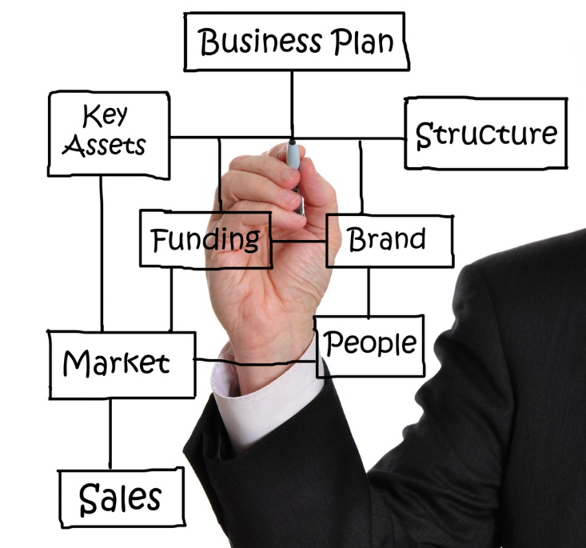
BUSINESS MODEL VS. BUSINESS PLAN
Business plan provides the details of your business
Equipment and staff needs
Leadership and management structure
Marketing strategies and tactics
Financial performance and projections
Capital needs

Slide 43
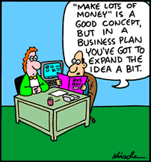
WRITING YOUR BUSINESS PLAN
Provides a road map for where you want the business to go
Some entrepreneurs spend months writing one while some never do
Most lenders and investors will require a formal plan to evaluate
Don’t write until “experiments” have turned into “sales”

Slide 44
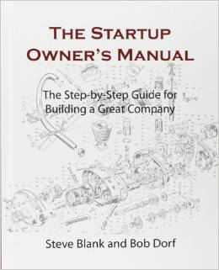
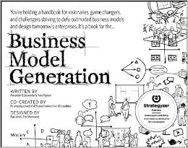
ADDITIONAL RESOURCES
Business Model Generation Alexander Osterwalder
The Startup Owner’s Manual Steve Blank

Slide 45
QUESTIONS???

