Slide 1
Patient Confidentiality and Privacy

Slide 2
Learning Objectives
Explain what patient confidentiality is and why it is important.
Describe advantages to electronic health records.
Know the legal and regulatory requirements for the Health Information Portability and Accountability Act.
Identify who is allowed access to the information in a patient's EHR and under what circumstances.
Describe potential consequences if patient confidentiality is breached.
Describe ways to avoid confidentiality breaches.

Slide 3
Watch: Electronic Health Records
https://www.youtube.com/watch?v=sjlcY9clbOk
2 minutes
Discussion: What is an electronic health record?
What are the advantages of electronic health records?

Slide 4
Watch: Transforming Children's Health Care Through Electronic Health Records
https://www.youtube.com/watch?v=V3954seCf_s
7 minutes
In pairs or small groups, discuss how the asthma patient’s care was improved through the use of an electronic health record.
Groups select a spokesperson and share with the class.

Slide 5
In the context of health care, what is patient privacy and confidentiality?
Credit for the next 4 slides given to University of Washington Department of Bioethics and Humanities accessed on 6.20.19 from https://depts.washington.edu/bhdept/ethics-medicine/bioethics-topics/detail/58

Slide 6
Confidentiality is one of the core duties of any health care provider.
Health care providers are those who care for patients. They can be doctors, nurses, home health aides, physical therapists, pharmacy technicians, clerical support and even cooks who work in the hospital food service and cafeteria.
Patients rights to confidentiality requires health care providers to keep a patient’s personal health information private unless consent to release the information is provided by the patient.

Slide 7
Why is confidentiality important?
Patients routinely share personal information with health care providers. If the confidentiality of this information were not protected, trust in the physician-patient relationship would be diminished. Patients would be less likely to share sensitive information, which could negatively impact their care.
Discussion: What could happen if patients do not trust their health care providers?
Creating a trusting environment by respecting patient privacy encourages the patient to seek care and to be as honest as possible during the course of a health care visit. (See also Physician-Patient Relationship.)
It may also increase the patient’s willingness to seek care. For conditions that might be stigmatizing, such as reproductive, sexual, public health, and psychiatric health concerns, confidentiality assures that private information will not be disclosed to family or employers without their consent.

Slide 8
What does the duty of confidentiality require?
The obligation of confidentiality prohibits the health care provider from disclosing information about the patient's case to others without permission and encourages the providers and health care systems to take precautions to ensure that only authorized access occurs.
Appropriate care often requires that information about patients be discussed among members of a health care team; all team members have authorized access to confidential information about the patients they care for and assume the duty of protecting that information from others who do not have access.
Electronic medical records can pose challenges to confidentiality.

Slide 9
What if a family member asks how the patient is doing?
While there may be cases where the physician feels naturally inclined to share information, such as responding to an inquiring spouse, the requirements for making an exception to confidentiality may not be met.
If there is not explicit permission from the patient to share information with family member, it is generally not ethically justifiable to do so.
Exceptions include minor children, situations when adults are under the care of a guardian, or when a family member is at specific risk of harm directly related to the diagnosis.
State law requires the report of certain communicable/infectious diseases to the public health authorities. In these cases, the duty to protect public health outweighs the duty to maintain a patient's confidence.
State laws requires reporting of children who need protection.

Slide 10
Legal Protection of Patient Information is Required through HIPAA
HIPAA = Health Information Portability and Accountability Act (1997)
Allows for appropriate discussion about the patient ONLY among health care professionals who are involved in the care of the patient.
Confidentiality includes anything about the patient, their current/past/future health or mental health conditions, their insurance (or lack of) where they live, what they do. Virtually anything that can identify the patient to other people.
In accordance with the Health Information Portability and Accountability Act of 1997 (HIPAA), institutions are required to have policies to protect the privacy of patients’ electronic information, including procedures for computer access and security.

Slide 11
Confidentiality Breach
A breach of patient confidentiality occurs when the patient’s personal information, without permission, is disclosed to a third party who is not involved with the patient’s care.
The disclosure can be oral or written. It can be by phone, email, even in the hospital elevator. Health care providers should not discuss patients in public areas where others may hear.
Accessing medical records without a need to know for the care of the patient, without permission, is also a breach.

Slide 12
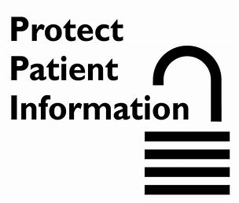
Watch: Electronic Health Records: Privacy and Security
https://www.youtube.com/watch?v=SMUFa5amPKs
2 minutes
Discussion: What does HIPAA stand for?
Discussion: Why is HIPAA important to us?

Slide 13
Watch: HIPAA Breach Notification
https://www.youtube.com/watch?v=hLCeTbw8NpQ
4 minutes
Discussion: Who is notified when a breach occurs?

Slide 14
What happens when confidentiality is breached?
Health care professionals can lose their jobs. It’s that serious.
Health care institutions will pay fines. Penalties for HIPAA violations can be issued by the US Department of Health and Human Services’ Office for Civil Rights (OCR) and state attorneys general.
Watch: HIPAA -- It Was an Innocent Mistake. Is it Also a HIPAA Breach?
https://www.youtube.com/watch?v=EwyeuHi47IY 2 minutes
https://www.hipaajournal.com/what-are-the-penalties-for-hipaa-violations-7096/

Slide 15
The four categories used for the penalty structure are as follows:
Tier 1: A violation that the covered entity was unaware of and could not have realistically avoided, had a reasonable amount of care had been taken to abide by HIPAA Rules
Tier 2: A violation that the covered entity should have been aware of but could not have avoided even with a reasonable amount of care. (but falling short of willful neglect of HIPAA Rules)
Tier 3: A violation suffered as a direct result of “willful neglect” of HIPAA Rules, in cases where an attempt has been made to correct the violation
Tier 4: A violation of HIPAA Rules constituting willful neglect, where no attempt has been made to correct the violation

Slide 16
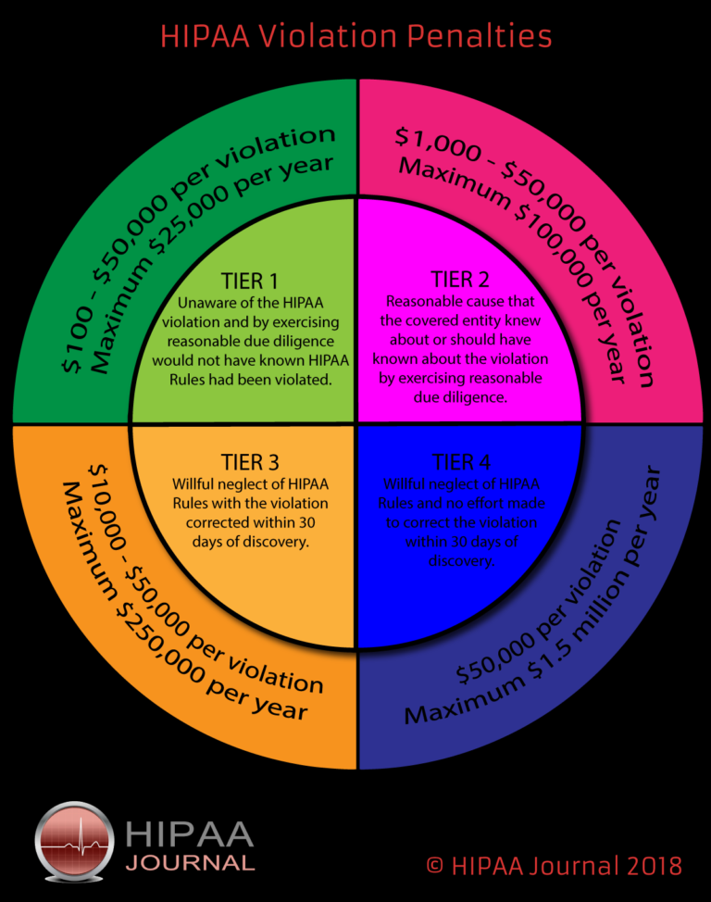
Each category of violation carries a separate HIPAA penalty. It is up to OCR to determine a financial penalty within the appropriate range. OCR considers a number of factors when determining penalties, such as the length of time a violation was allowed to persist, the number of people affected and the nature of the data exposed. An organization´s willingness to assist with an OCR investigation is also taken into account. The general factors that can affect the level of financial penalty also include prior history, the organization’s financial condition and the level of harm caused by the violation.
Tier 1: Minimum fine of $100 per violation up to $50,000
Tier 2: Minimum fine of $1,000 per violation up to $50,000
Tier 3: Minimum fine of $10,000 per violation up to $50,000
Tier 4: Minimum fine of $50,000 per violation

Slide 17
Watch: Patient Confidentiality (includes cases) 24 minutes
https://www.youtube.com/watch?v=oxZA-OKKRzw
Recap violations and consequences that occurred to anyone involved in a the breaches.

Slide 18
In Class or Out of Class Assignment
Students conduct online research of patient confidentiality breaches and report specific situations to the class.

Slide 19
Unit Reflection
Why is confidentiality and privacy of patient information important?
What does the law require?
What happens if a health care professional breaches patient confidentiality?
Who needs to be notified if a breach occurs?
What do health care professionals do to prevent breaches in confidentiality?
How can your privacy be compromised with cell phones and computers.

