Slide 1
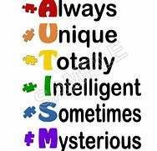
Understanding Autism
Spectrum Disorder
Watch: Things that People with Disabilities wish you knew – 5 minutes
https://www.youtube.com/watch?v=_b7k6pEnyQ4
Class discussion: What was surprising or new information?
How can you use the information?

Slide 2
Learning Outcomes
Describe recent statistics for people with disabilities
List the general categories of disabilities
Differentiate between neuro-typical and neuro-diverse
Summarize Autism Spectrum Disorder
List some challenges people with Autism Spectrum Disorder may experience
Discuss what future employers should know about applicants with Autism Spectrum Disorder

Slide 3
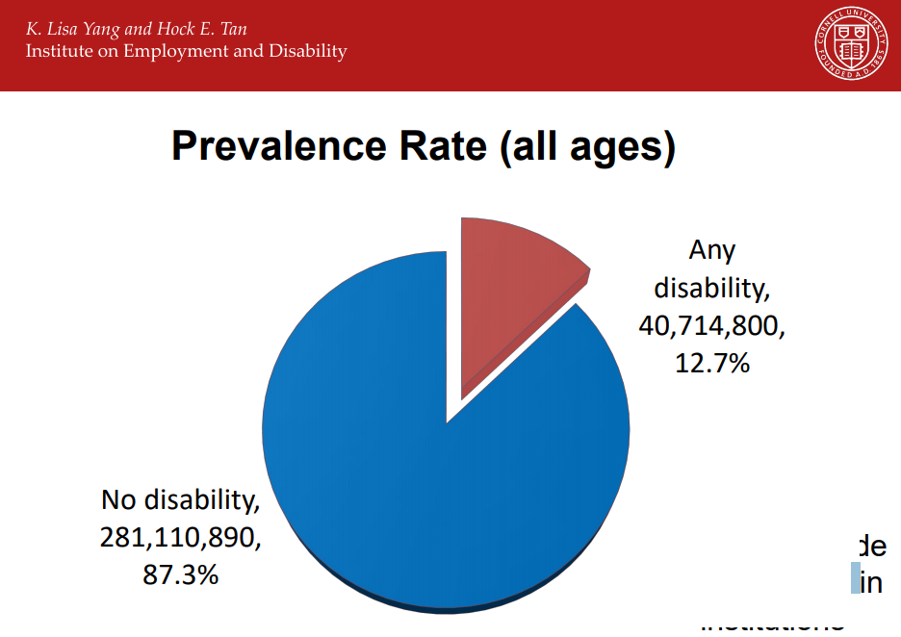
Disability Statistics, Institute on Employment and Disability, Cornell University
(Slides 2 – 11 retrieved on 6.19.19 from http://disabilitystatistics.org/)
Almost 13% of Americans have a disability.
How big is your town or city?
How many residents in your town or city may
Have a disability?
Do you always know who they are?
When do you know?
When do you not know?

Slide 4
General Categories of Disabilities
Hearing
Visual
Ambulatory
Cognitive (Because of a physical, mental, or emotional condition, this person has serious difficulty concentrating, remembering, or making decisions)
Self Care (taking care of themselves such as bathing, eating)
Independent living (Because of a physical, mental, or emotional condition, this person has difficulty doing errands alone such as visiting a doctor’s office or shopping)

Slide 5
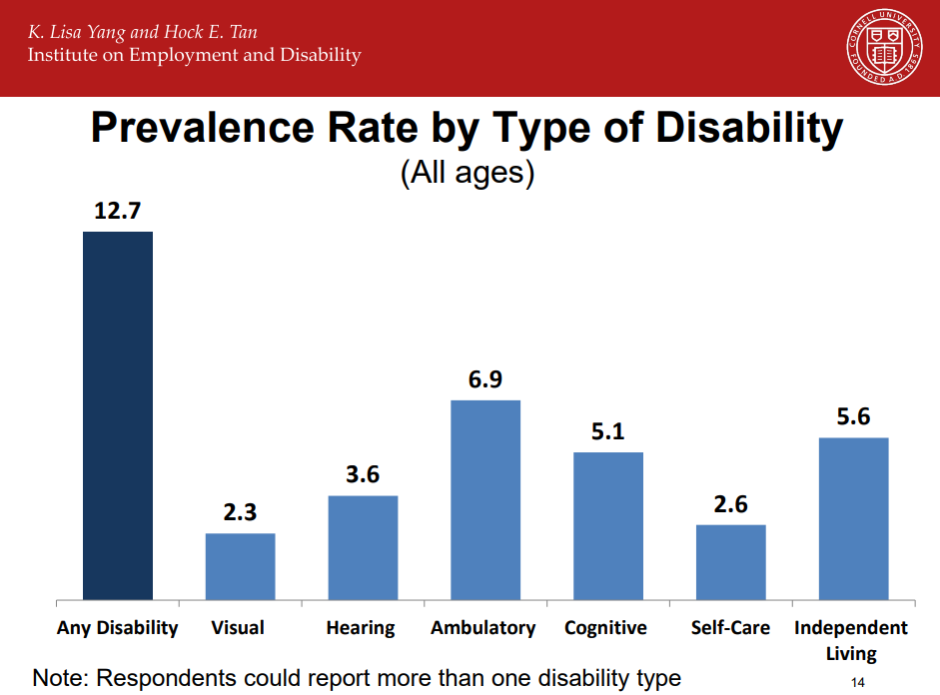
The most frequently experienced disability is one that interferes with daily, independent living and one’s ability to walk and climb stairs.
Ambulatory self-care
Independent living

Slide 6
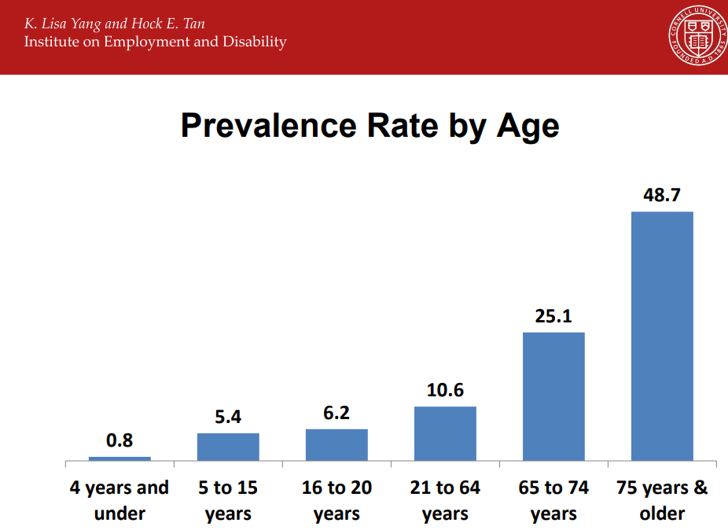
It seems that the older people become, the more likely they are to experience a disability.
Why do you think this occurs?

Slide 7
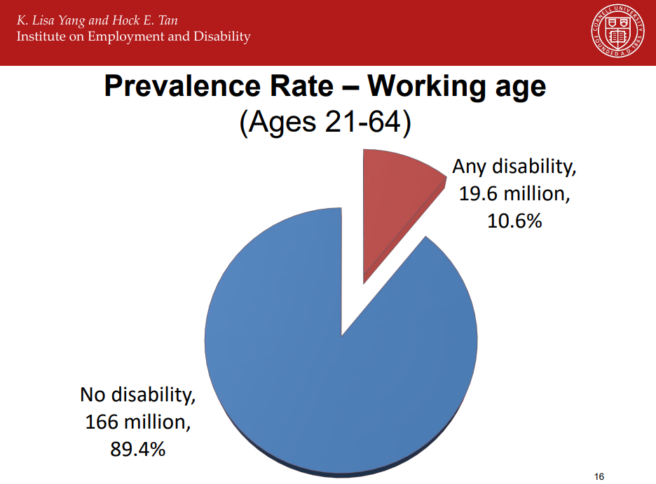
Of Americans who are in the workforce (meaning they are between the ages of 21 and 64 and are working), almost 11% have a disability.
Having a disability is pretty common. It’s not unusual.

Slide 8
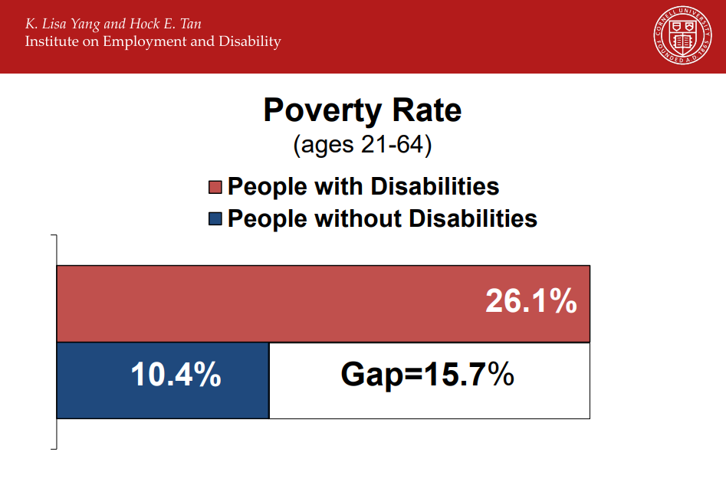
Unfortunately, life in poverty is significantly higher for people with disabilities.
Poverty occurs for 10.4% of Americans who do not have disabilities.
Poverty occurs for 26.1% of Americans with disabilities.

Slide 9
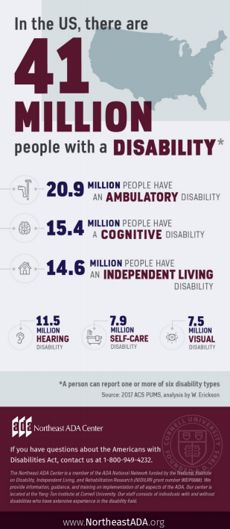
41 million people in the United States have a disability.

Slide 10
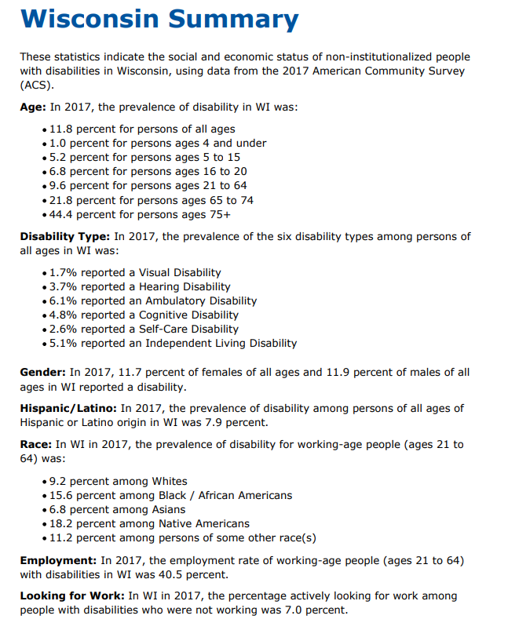
In Wisconsin…..
http://www.disabilitystatistics.org/StatusReports/2017-PDF/2017-StatusReport_WI.pdf?CFID=20062669&CFTOKEN=ee5b6eae8414a64e-60583DFD-E415-F38E-1247D59CBBFA3068

Slide 11
Watch: How to Treat a Person with Disabilities, According to People with Disabilities – 4 minutes
https://www.youtube.com/watch?v=W6c6JLbczC8
Class discussion on what they heard and how they feel about the information in the video.
What will they do with the information?

Slide 12
So far from the first 10 slides:
What was surprising information?
What is confusing information?
What is the most important information you’ve heard?

Slide 13
Reminder of the General Categories of Disabilities
Hearing
Visual
Ambulatory
Cognitive (Because of a physical, mental, or emotional condition, this person has serious difficulty concentrating, remembering, or making decisions)
Self Care (taking care of themselves such as bathing, eating)
Independent living (Because of a physical, mental, or emotional condition, this person has difficulty doing errands alone such as visiting a doctor’s office or shopping)

Slide 14
Cognitive Disabilities – Classifications
Retrieved on 6.19.19 from Utah State University Center for Personals with Disabilities https://webaim.org/articles/cognitive/)
Clinical
Functional
Clinical diagnoses of cognitive disabilities include
Autism
Down Syndrome
traumatic brain injury (TBI)
Dementia
Less severe cognitive conditions include
  attention deficit disorder (ADD)
  dyslexia (difficulty reading)
  dyscalculia (difficulty with math)
  learning disabilities in general.
Functional disabilities focus on the resulting abilities and challenges. Some of the main categories of functional cognitive disabilities include deficits or difficulties with:
Memory
Problem-solving
Attention
Reading, linguistic, and verbal comprehension
Math comprehension
Visual comprehension

Slide 15

New Terms
Neurotypical
Neurodiverse
Neurotypical and is often used to refer to people who are not on the autism spectrum. That is, they do not have a diagnosis of autism spectrum disorder.
It is a combination of the words “neurological” and “typical”.
Neurodiversity is the idea that neurological differences like autism are the result of normal, natural variation in the human genome.
This represents new and fundamentally different way of looking at conditions that were traditionally viewed as pathology; it’s a viewpoint that is not universally accepted though it is increasingly supported by science.
That science suggests conditions like autism have a stable prevalence in human society as far back as we can measure. We are realizing that autism, and other conditions emerge through a combination of genetic predisposition and environmental interaction; they are not the result of disease or injury.
https://www.psychologytoday.com/us/blog/my-life-aspergers/201310/what-is-neurodiversity

Slide 16
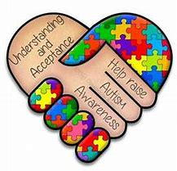
What is Autism Spectrum Disorder?
Autism spectrum disorder (ASD) is a developmental disorder that affects communication and behavior. Although autism can be diagnosed at any age, it is said to be a “developmental disorder” because symptoms generally appear in the first two years of life.
People with ASD have:
Difficulty with communication and interaction with other people
Restricted interests and repetitive behaviors
Symptoms in these areas that interfere with the person’s ability to function properly in school, work, and other areas of life
https://www.nimh.nih.gov/health/topics/autism-spectrum-disorders-asd/index.shtml

Slide 17
Restrictive / repetitive behaviors may include:
Social communication / interaction behaviors may include:
Making little or inconsistent eye contact
Tending not to look at or listen to people
Rarely sharing enjoyment of objects or activities by pointing or showing things to others
Failing to, or being slow to, respond to someone calling their name or to other verbal attempts to gain attention
Having difficulties with the back and forth of conversation
Often talking at length about a favorite subject without noticing that others are not interested or without giving others a chance to respond
Having facial expressions, movements, and gestures that do not match what is being said
Having an unusual tone of voice that may sound sing-song or flat and robot-like
Having trouble understanding another person’s point of view or being unable to predict or understand other people’s actions
Repeating certain behaviors. For example, repeating words or phrases.
Having a lasting intense interest in certain topics, such as numbers, details, or facts
Having overly focused interests, such as with moving objects or parts of objects
Getting upset by slight changes in a routine
Being more or less sensitive than other people to sensory input, such as light, noise, clothing, or temperature
People with ASD may also experience sleep problems and irritability. Although people with ASD experience many challenges, they may also have many strengths, including:
  Being able to learn things in detail and remember information for long periods of time
  Being strong visual and auditory learners
  Excelling in math, science, music, or art
https://www.nimh.nih.gov/health/topics/autism-spectrum-disorders-asd/index.shtml

Slide 18
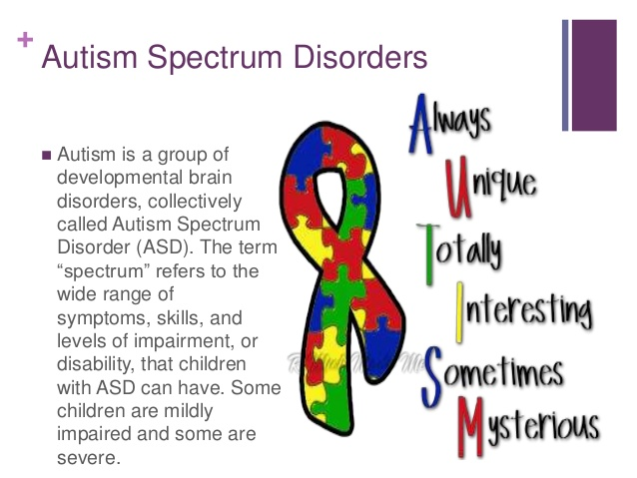
What is Autism Spectrum Disorder?
Autism is known as a “spectrum” disorder because there is wide variation in the type and severity of symptoms people experience.
ASD occurs in all ethnic, racial, and economic groups.
Although ASD can be a lifelong disorder, treatments and services can improve a person’s symptoms and ability to function.
Watch: Jake: Math Prodigy https://www.youtube.com/watch?v=OR36jrx_L44
13 minutes
https://www.nimh.nih.gov/health/topics/autism-spectrum-disorders-asd/index.shtml

Slide 19
Indicators of autism usually appear by age 2 or 3. Some associated development delays can appear even earlier, and often, it can be diagnosed as early as 18 months. Research shows that early intervention leads to positive outcomes later in life for people with autism.
We know that there is not one autism but many subtypes, most influenced by a combination of genetic and environmental factors.
Because autism is a spectrum disorder, each person with autism has a distinct set of strengths and challenges. The ways in which people with autism learn, think and problem-solve can range from highly skilled to severely challenged.
https://www.autismspeaks.org/what-autism

Slide 20
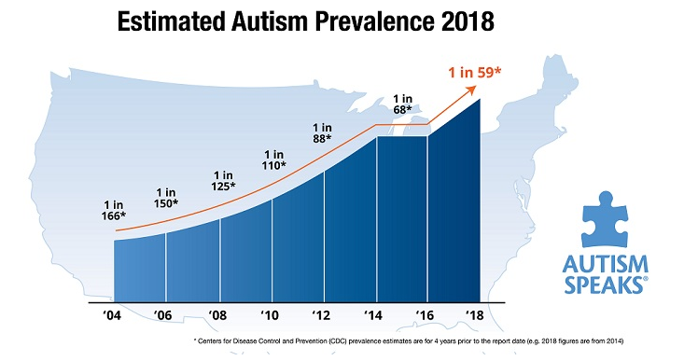
CDC estimates 1 in 59 children have Autism Spectrum Disorder.
The incidence or prevalence is on the rise. Most agree it is because of better and earlier diagnosis.

Slide 21
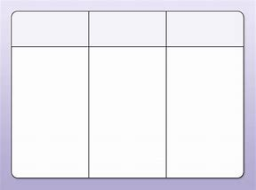
Watch: Autism — what we know (and what we don't know yet) | Wendy Chung
Students take a piece of paper and draw columns. During the video, take notes on:
  What is new information?
  What is confusing information?
  What information you already know?
https://www.youtube.com/watch?v=wKlMcLTqRLs
15.5 minutes
Class discussion follows the video
What is new information?
  What is confusing information?
  What information did you already know?
  How will you use the information?

Slide 22
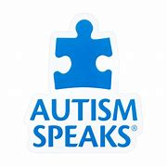
In Class: Students in Pairs Research Autism Speaks
https://www.autismspeaks.org/
Explore the website.
List what the organization does.
Everyone stand up. Pairs take turns describing one action that they found on the website.
Teacher writes responses on the board, overhead or easel paper.
When a team has exhausted their list, they sit down.
The last pair standing earns applause for comprehensive research.

Slide 23
Hiring autistic workers
IT related roles https://www.youtube.com/watch?v=3b5OGx-v6Ao
11.5 minutes
AND/OR
Skilled workers: https://www.youtube.com/watch?v=c_o5shDrPiM
9 minutes
Discussion: What should everyone know?

Slide 24
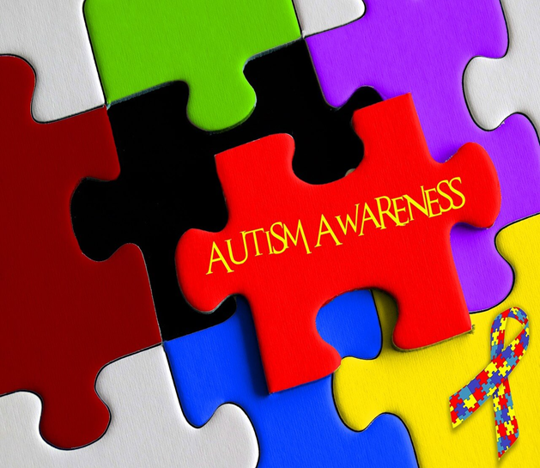
Final Reflection
What was the most important part of this unit to you and why?
All students weigh in…

