Slide 1
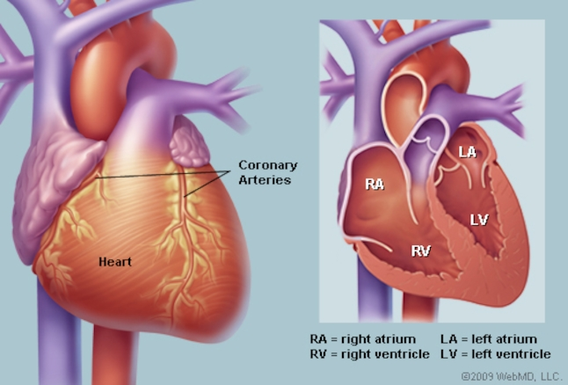
The Human Heart and Heart Attack
Watch: The Human Circulatory System 5 minutes
https://www.bing.com/videos/search?q=Human+Heart+Beating+Inside+Body&&view=detail&mid=AEA4050A7D69CB30C6CFAEA4050A7D69CB30C6CF&&FORM=VRDGAR

Slide 2
Learning Objectives
Summarize the function of the human heart
Describe the medical term for a heart attack
Explain what causes a heart attack
Describe the symptoms of a heart attack
Identify ways we can prevent a heart attack

Slide 3
Pre-Test On a piece of paper, write your answers
What is a heart attack?
What Over the Counter medication can be used to prevent a heart attack?
What is the medical term for a heart attack?
What causes a heart attack?
What are the symptoms of a heart attack?
What are the risk factors for atherosclerosis and heart attack?
How to diagnose a heart attack
What is the treatment for heart attack?
How can you prevent a heart attack?

Slide 4
The Human Heart
The muscle that pumps blood received from veins into arteries throughout the body. It is positioned in the chest behind the sternum (breastbone; in front of the trachea, esophagus, and aorta; and above the diaphragm muscle that separates the chest and abdominal cavities.
The normal heart is about the size of a closed fist, and weighs about 10.5 ounces. It is cone-shaped, with the point of the cone pointing down to the left. Two-thirds of the heart lies in the left side of the chest with the balance in the right chest.
Image Source: MedicineNet, Inc.
Text: MedicineNet, Inc.
https://www.medicinenet.com/image-collection/heart_picture/picture.htm

Slide 5
The Heart - Detail
The heart is composed of specialized cardiac muscle, and it is four-chambered, with a right atrium and ventricle, and an anatomically separate left atrium and ventricle. The blood flows from the systemic veins into the right atrium, thence to the right ventricle, from which it is pumped to the lungs, then returned into the left atrium, thence to the left ventricle, from which it is driven into the systemic arteries.
The heart is thus functionally composed of two hearts: the right heart and the left heart. The right heart consists of the right atrium, which receives deoxygenated blood from the body, and the right ventricle which pumps it to the lungs under low pressure; and the left heart, consisting of the left atrium, which receives oxygenated blood from the lung, and the left ventricle, which pumps it out to the body under high pressure.
Image Source: MedicineNet, Inc.
Text: MedicineNet, Inc.
https://www.medicinenet.com/image-collection/heart_picture/picture.htm

Slide 6
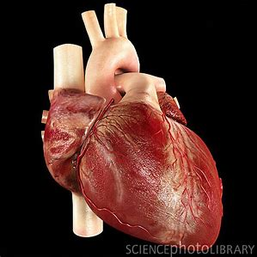
Heart Facts
A human heart is roughly the size of a large fist.
The heart weighs between about 10 to 12 ounces (280 to 340 grams) in men and 8 to 10 ounces (230 to 280 grams) in women.
The heart beats about 100,000 times per day (about 3 billion beats in a lifetime).
An adult heart beats about 60 to 80 times per minute.
Newborns' hearts beat faster than adult hearts, about 70 to 190 beats per minute.
The heart pumps about 6 quarts (5.7 liters) of blood throughout the body.
Source: Human Heart: Anatomy, Function & Facts By Tanya Lewis, Staff Writer | March 22, 2016 Live Science https://www.livescience.com/34655-human-heart.html

Slide 7
Watch: The Heart and Circulatory System - How They Work (3 minutes)
https://www.youtube.com/watch?v=CWFyxn0qDEU

Slide 8
Heart Disease and Heart Attacks WebMD Medical Reference Reviewed by James Beckerman, MD, FACC on November 05, 2018. Retrieved on 6.9.19 from https://www.webmd.com/heart-disease/heart-disease-heart-attacks#1
More than 1 million Americans have heart attacks each year. A heart attack, or myocardial infarction (MI), is an event that causes permanent damage to the heart muscle. "Myo" means muscle, "cardial" refers to the heart and "infarction" means death of muscle tissue due to lack of blood and oxygen supply.
What Happens During a Heart Attack?
Heart muscle requires a constant supply of oxygen-rich blood to nourish it. The coronary arteries provide the heart with this critical blood supply. If you have coronary artery disease, those arteries become narrow -- or obstructed -- and blood cannot flow as well as it should. Fatty matter, calcium, proteins and inflammatory cells build up within the arteries to form plaques of different sizes and consistencies.
This is sometimes what causes the initial symptoms of coronary artery disease. With the build-up of plaque, there is less delivery of oxygen to the heart muscle, especially when there is a demand for oxygen (during exertion or exercise) and chest pain or symptoms can develop.

Slide 9
The outer surface of the plaque may rupture or crack and platelets (disc-shaped particles in the blood that help form blood clots) then come to the area to form blood clots around the plaque -- like a scab. If a blood clot totally obstructs the artery, the heart muscle can become starved for oxygen. This is called ischemia. And within a short time (even minutes), death of heart muscle cells occurs, causing permanent damage. This is a heart attack.
While it is unusual, a heart attack can also be caused by a spasm of a coronary artery. Coronary arteries have a muscle lining which can contract or relax depending on the needs of the heart muscle at a given time. During a coronary spasm, the coronary arteries constrict or spasm without warning, reducing blood supply to the heart muscle and potentially causing a heart attack. It may occur at rest and can even occur in people without significant coronary artery disease.

Slide 10
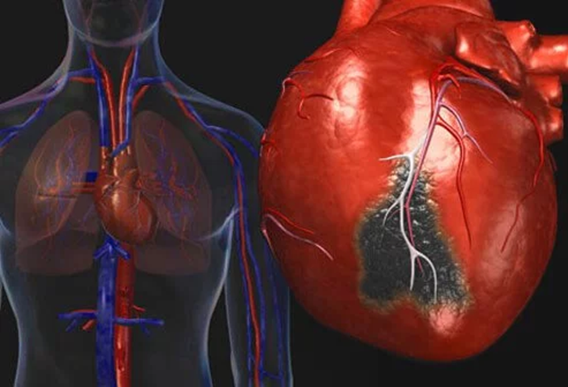
Each coronary artery supplies blood to a specific region of heart muscle. The amount of damage to the heart muscle depends on the size of the area supplied by the blocked artery and the time between injury and treatment. Earlier treatment can reduce the impact of the heart attack.
Healing of the heart muscle begins soon after a heart attack and takes about eight weeks. Similar to a skin wound, the heart's wound heals and a scar will form in the damaged area. However, the new scar tissue does not contract. Therefore, the heart's pumping ability can be reduced after a heart attack. The amount of lost pumping ability depends on the size and location of the scar.

Slide 11
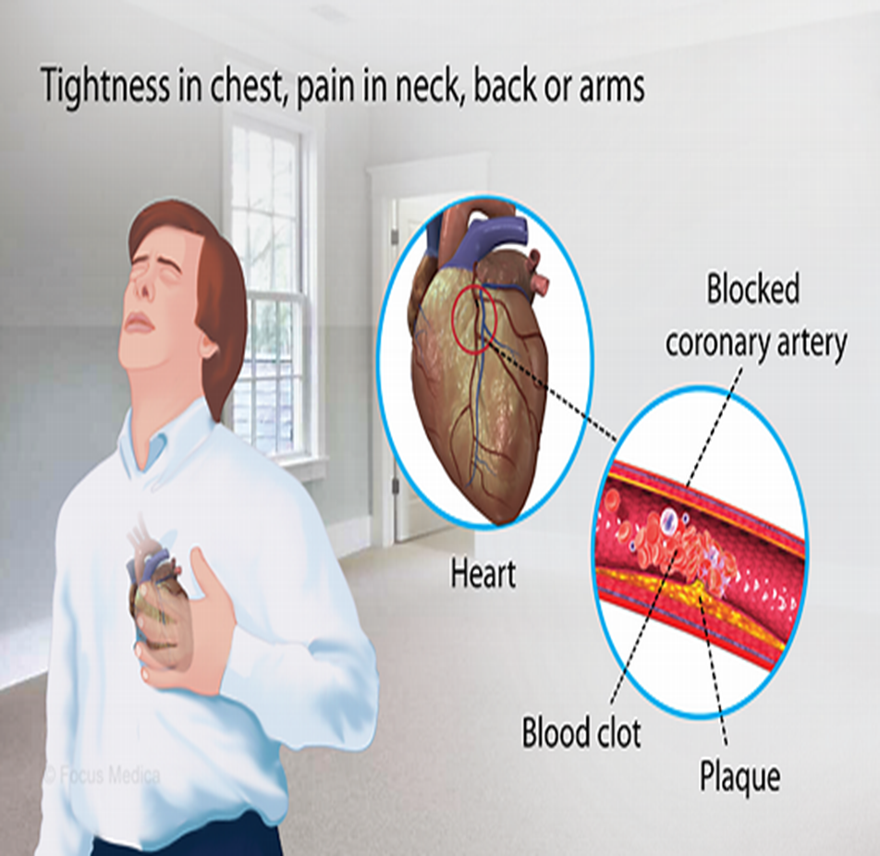
Symptoms of a Heart Attack
• Discomfort, pressure, heaviness, or pain in the chest, arm or below the breastbone
• Discomfort radiating to the back, jaw, throat or arm
• Fullness, indigestion or choking feeling (may feel like heartburn)
• Sweating, nausea, vomiting or dizziness
• Extreme weakness, anxiety or shortness of breath
• Rapid or irregular heartbeats
• Fatigue
During a heart attack, symptoms may last 30 minutes or longer and are not relieved by rest or nitroglycerin.
Some people have a heart attack without having any symptoms (a "silent" myocardial infarction). A silent MI can occur in anyone, though it is more common among diabetics.

Slide 12
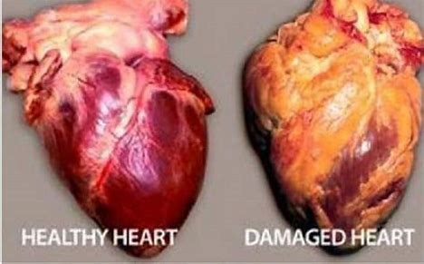
Watch: What Happens in a Heart Attack vs. Cardiac Arrest (1 minute, 7 seconds)
https://www.youtube.com/watch?v=69CQsdPC2i8

Slide 13
How Doctors Diagnose a Heart Attack
To diagnose a heart attack, an emergency care team will ask you about your symptoms and begin to evaluate you. The diagnosis of the heart attack is based on your symptoms as well as your test results. The goal of treatment is to treat you quickly and limit heart muscle damage.
Electrocardiogram. The electrocardiogram (ECG or EKG) can provide information about the extent and location of heart muscle damage. It also detects your heart rate and rhythm. whether or not you are having a heart attack.
What is an EKG? 5 minutes
https://www.youtube.com/watch?v=jq6zqx8E-Cg
Blood tests. Blood may be drawn to measure levels of cardiac enzymes that indicate heart muscle damage. These enzymes are normally found inside the cells of your heart and are needed for their function. When your heart muscle cells are injured, their contents -- including the enzymes -- are released into the bloodstream. By measuring the levels of these enzymes, the doctor can determine approximately when the heart attack started.
Echocardiography. An echocardiogram (also called an echo) is an ultrasound test that can be used to learn how the heart is pumping overall and what areas might not be pumping normally. The echo can also determine if any structures of the heart (such as the valves and septum) have been injured during the heart attack.
Echocardiogram 3 minutes
https://www.youtube.com/watch?v=0eKdhHF-JLg
Cardiac catheterization. Cardiac catheterization, also called a cardiac cath or an angiogram, is an invasive test performed to directly visualize (using X-rays) the size and extent of blockage in the coronary arteries. It is frequently recommended in the first hours of a heart attack if medications are not relieving the ischemia or symptoms. The cardiac catheterization can be used to help your doctor determine which procedure is needed to treat the blockage. Balloon angioplasty, coronary stenting, and coronary artery bypass surgery may be recommended in addition to medications.
New Route to the Heart – Mayo Clinic 3 minutes
https://www.youtube.com/watch?v=vuHHjIRswDE

Slide 14
Treatment
Once a heart attack is diagnosed, treatment begins immediately -- possibly in the ambulance or emergency room. Drugs, catheter-based procedures, and surgery are used to treat a heart attack.
What Drugs Are Used to Treat a Heart Attack?
The goals of drug therapy are to break up or prevent blood clots, prevent platelets from gathering and sticking to the plaque, stabilize the plaque, and prevent further damage.
These medications must be given as soon as possible to decrease the amount of heart damage. The longer the delay in starting these drugs, the more damage can occur and the less benefit they can provide.
Drugs used to treat a heart attack may include:
Aspirin to prevent blood clotting that may worsen the heart attack.
Antiplatelets to prevent blood clotting.
Thrombolytic therapy ("clot busters") to dissolve blood clots that are present in the heart's arteries.
Any combination of the above
Other drugs, given during or after a heart attack, lessen your heart's workload, improve the functioning of the heart, widen or dilate your blood vessels, decrease your pain, and guard against any life-threatening heart rhythms.

Slide 15
In pairs or as a class: Play the ECG/EKG Game by Nobel Prize.org
https://educationalgames.nobelprize.org/educational/medicine/ecg/ecg.html

Slide 16
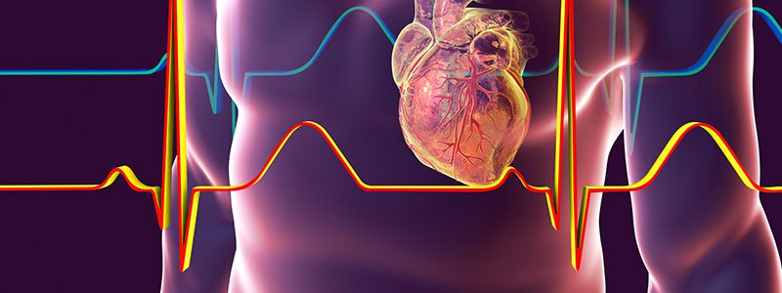
In pairs or as a class: Take the Heart Disease Quiz
https://www.medicinenet.com/heart_disease_quiz/quiz.htm

Slide 17
Post-Test On a piece of paper, write your answers
What is a heart attack?
What Over the Counter medication can be used to prevent a heart attack?
What is the medical term for a heart attack?
What causes a heart attack?
What are the symptoms of a heart attack?
What are the risk factors for atherosclerosis and heart attack?
How to diagnose a heart attack
What is the treatment for heart attack?
How can you prevent a heart attack?

Slide 18
Preventing Heart Disease is easy, begins now, and is simple to do!
Choosing healthy meal and snack options can help you avoid heart disease and its complications. Be sure to eat plenty of fresh fruits and vegetables.
Choosing healthy meal and snack options can help you avoid heart disease and its complications. Be sure to eat plenty of fresh fruits and vegetables.
By living a healthy lifestyle, you can help keep your blood pressure, cholesterol, and sugar normal and lower your risk for heart disease and heart attack. A healthy lifestyle includes the following:
Eating a healthy diet.
Maintaining a healthy weight.
Getting enough physical activity.
Not smoking or using other forms of tobacco.
Limiting alcohol use.
https://www.cdc.gov/heartdisease/healthy_living.htm

Slide 19
In small groups or pairs compare your pre and post learning answers. What did you know before this lesson? What new information did you learn? Discuss with the class…

Slide 20
End the class through discussion on lifestyle changes students will commit to.

