Slide 1
BUSINESS EXPENSES

Slide 2
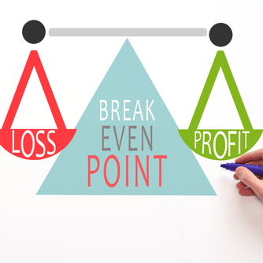
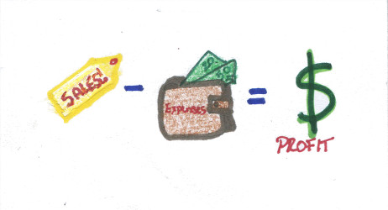
BUSINESS EXPENSES
VOCABULARY TERMS
Expenses
Revenue
Money generated from sales
Money spent to run the business
Break Even Point
Profit
The point where the revenue of a business equals it expenses
When a business makes more in revenue that it pays in expenses
Revenue (Sales) - Expenses = Profits

Slide 3
BUSINESS EXPENSES CATEGORIES & CLASSIFICATIONS
Operating
Categories
Personal
Startup
2
1
FIXED
or VARIABLE
3
FIXED
or VARIABLE
FIXED
or VARIABLE
Classifications

Slide 4
BUSINESS EXPENSES CATEGORIES
Startup Expenses
Expenses that occur just once as entrepreneurs are starting
Examples Include -
Fixtures
Beginning inventory
Legal Fees
Equipment
Licenses Permits
Grand Opening Advertising

Slide 5
BUSINESS EXPENSES CATEGORIES
Operating Expenses
Regular expenses that occur after the business has been opened
Examples Include -
Rent Insurance
Repairs Advertising
Mortgage Payroll
Taxes Inventory

Slide 6
BUSINESS EXPENSES CATEGORIES
Personal Expenses
Expenses that are necessary for entrepreneurs to live day-to-day
Examples Include -
Rent/Mortgage Transportation
Medical Bills Food
Clothing Entertainment

Slide 7
BUSINESS EXPENSES CLASSIFICATIONS
Fixed And Variable
Expenses
Fixed
Variable
Expenses that do
not change
Examples:
Monthly mortgage
Insurance
Rent payments
Usually change from
month-to-month
Examples:
Wages
Utilities
Supplies
.

Slide 8
BUSINESS EXPENSES
FRANCHISE EXPENSES EXAMPLE
Expense | Category | Classification
Advertising | Operating | Variable
Travel to Meetings | Personal | Variable
Business Permits | Startup | Fixed

Slide 9
Types of Expenses
Activity
**Use Your Notes for Help

