Slide 1
Digital Citizenship Toolkit

Slide 2
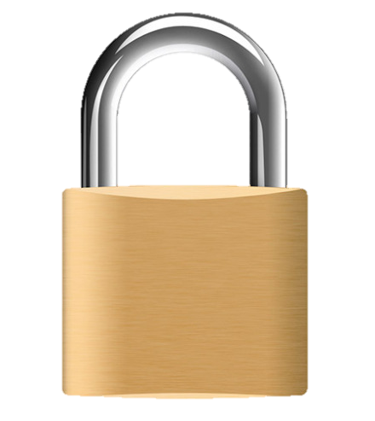
Safety
padlock

Slide 3

Safety
toothbrush

Slide 4
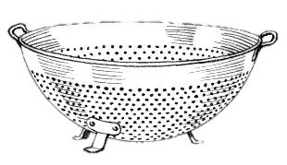
Safety
Strainer

Slide 5
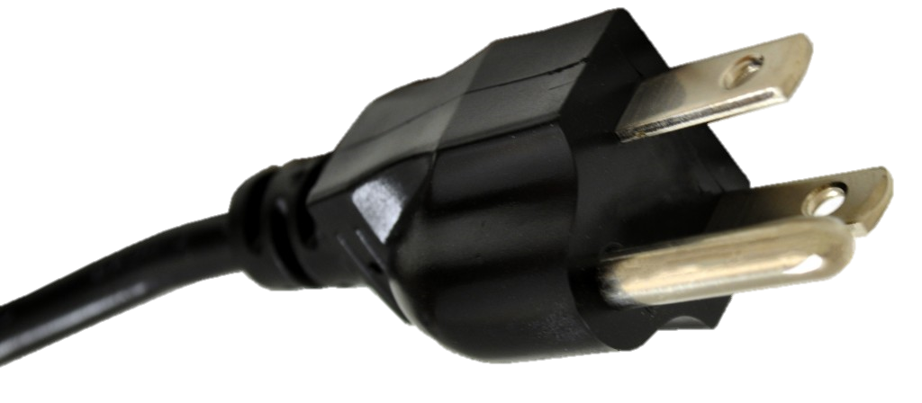
Safety
Plug in

Slide 6
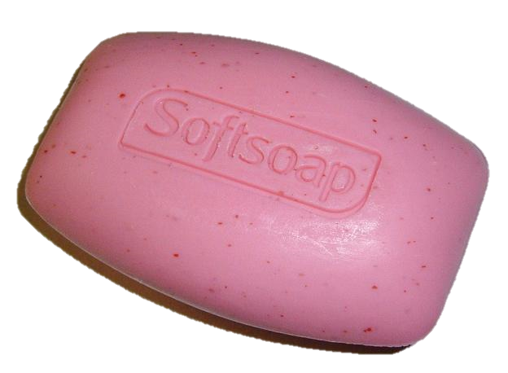
Respect
soap

Slide 7
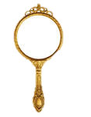
Respect
mirror

Slide 8

Respect
Sheet of Paper

Slide 9

Reputation
Packet of Seeds
This Photo by Unknown Author is licensed under CC BY-SA

Slide 10
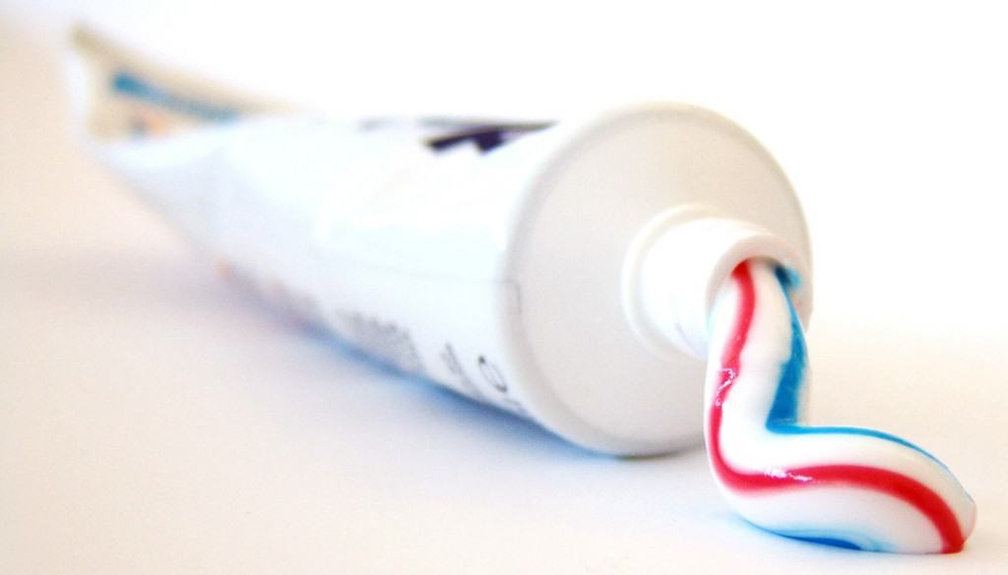
Reputation
Toothpaste

Slide 11
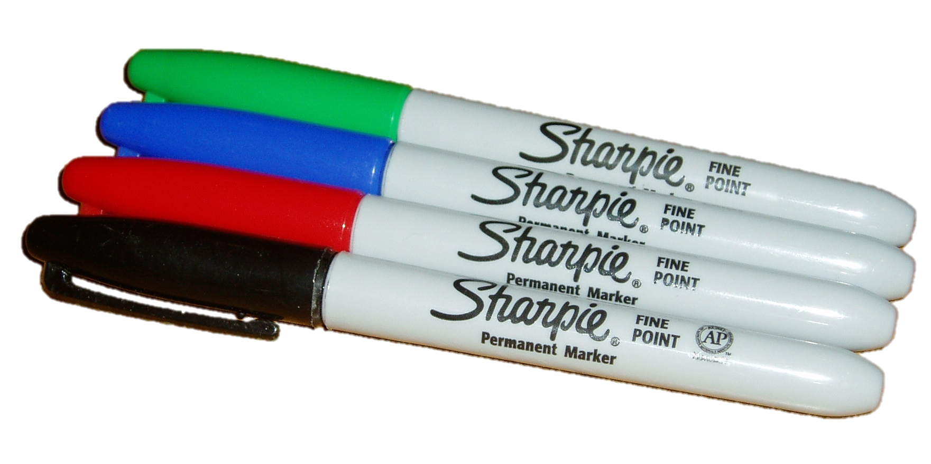
reputation
Permanent marker

Slide 12

Reputation
Magnifying Glass

Slide 13

reputation
Band-Aids

