Slide 1
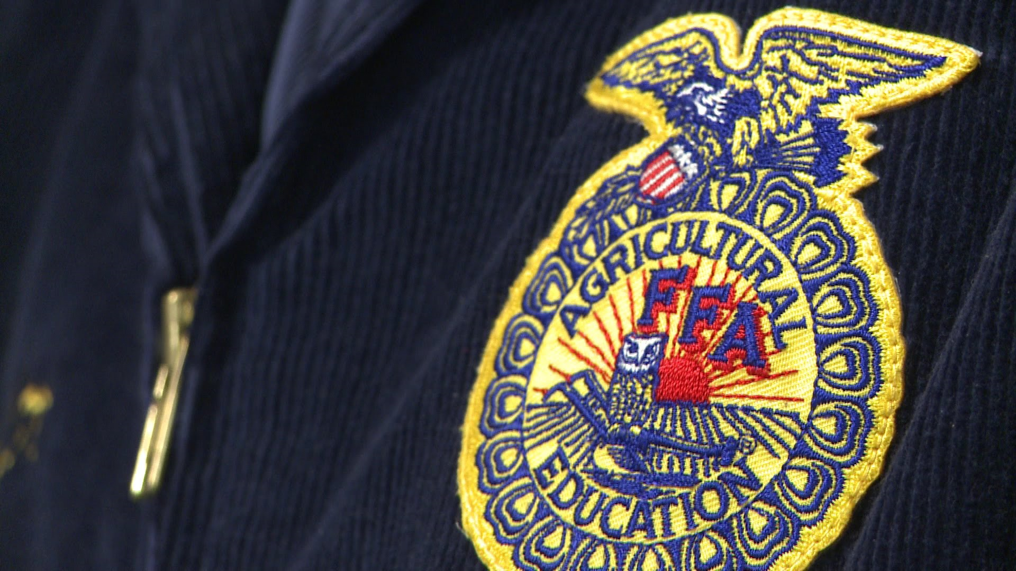
FFA Creed
Ms. Albert
Where did the author write the FFA Creed?
Wisconsin!

Slide 2
What Are you passionate about?

Slide 3
Why is passion and drive important?
Is this important to consider when choosing a future career?

Slide 4
Today’s Objectives
I will be able to identify the importance of passion and drive within one’s work.
I will be able to explain in my own words the value of the FFA Creed.
I will be able to create a piece or work that is representative of the FFA Creed.

Slide 5
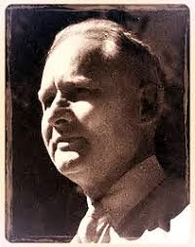
A little about the author
Author: E.M. Tiffany
Originally from Kansas
Wrote Creed in Wisconsin
Grew up on a family farm in the later 1800s
After high school attended college
Graduated in 1902
Classics Degree
Began work as high school principal
Pursued master’s degree in agricultural education
Worked at University of Wisconsin
Training vocational agriculture teachers

Slide 6
A little about the creed
Was written in 1928
Written while Tiffany was setting up exhibit for first Wisconsin state FFA Convention
“I got the idea that a statement of ideals for FFA might fit in the exhibit.” –E.M. Tiffany
First printed in 1929
Adopted by the National FFA Organization in 1930
Third National FFA Convention
Solid foundation for FFA’s principles

Slide 7
The FFA Creed
“I believe in the future of agriculture, with a faith born not of words but of deeds- achievements won by the present and past generations of agriculturalists; in the promise of better days through better ways, even as the better things we now enjoy have come to us from the struggles of former years.

Slide 8
The FFA Creed
I believe that to live and work on a good farm, or to be engaged in other agricultural pursuits, is pleasant as well as challenging; for I know the joys and discomforts of agricultural life and hold an inborn fondness for those associations which, even in hours of discouragement, I cannot deny.

Slide 9
The FFA Creed
I believe in leadership from ourselves and respect from others. I believe in my own ability to work efficiently and think clearly, with such knowledge and skill as I can secure, and in the ability of progressive agriculturists to serve our own and the public interest in producing and marketing the product of our toil.

Slide 10
The ffa Creed
I believe in less dependence on begging and more power in bargaining; in the life abundant and enough honest wealth to help make it so – for others as well as myself; in less need for charity and more of it when needed; in being happy myself and playing square with those whose happiness depends upon me.

Slide 11
The FFA Creed
I believe that American agriculture can and will hold true to the best traditions of our national life and that I can exert an influence in my home and community which will stand solid for my part in that inspiring task.”

Slide 12
Take some time…
Mark up your FFA Creed to circle, star, and mark in your own way the parts that stand out to you.
Be prepared to explain why these certain parts stood out to you.
Have at least one part from each paragraph of the FFA Creed.

Slide 13
Discussion
What stood out to you?
Why did this stand out to you?

Slide 14
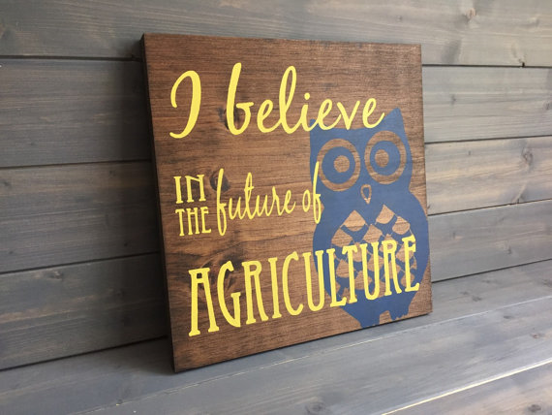
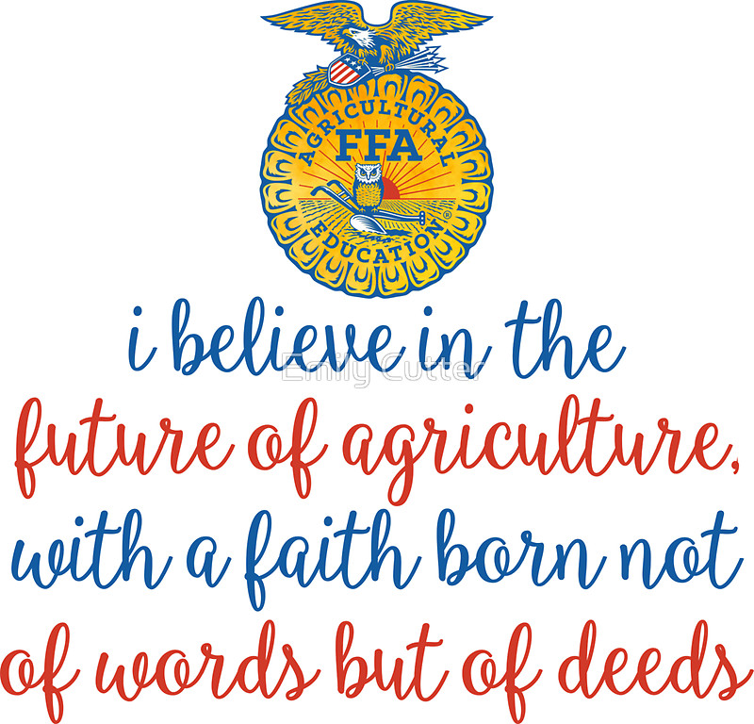
FFA Creed Assignment
Choice of Assignments:
Memorize FFA Creed and present it to the class
Create an art piece symbolic of the FFA Creed
Drawing
Painting
Create presentation explaining the parts of the FFA Creed and present it to the class
Create a poster about the FFA Creed elements
Write a script for a play based on the principles of the FFA Creed
Don’t like any of these options? Think of a project idea related to the FFA Creed and get it approved by Ms. Albert!

