Slide 1
CAREERS

Slide 2
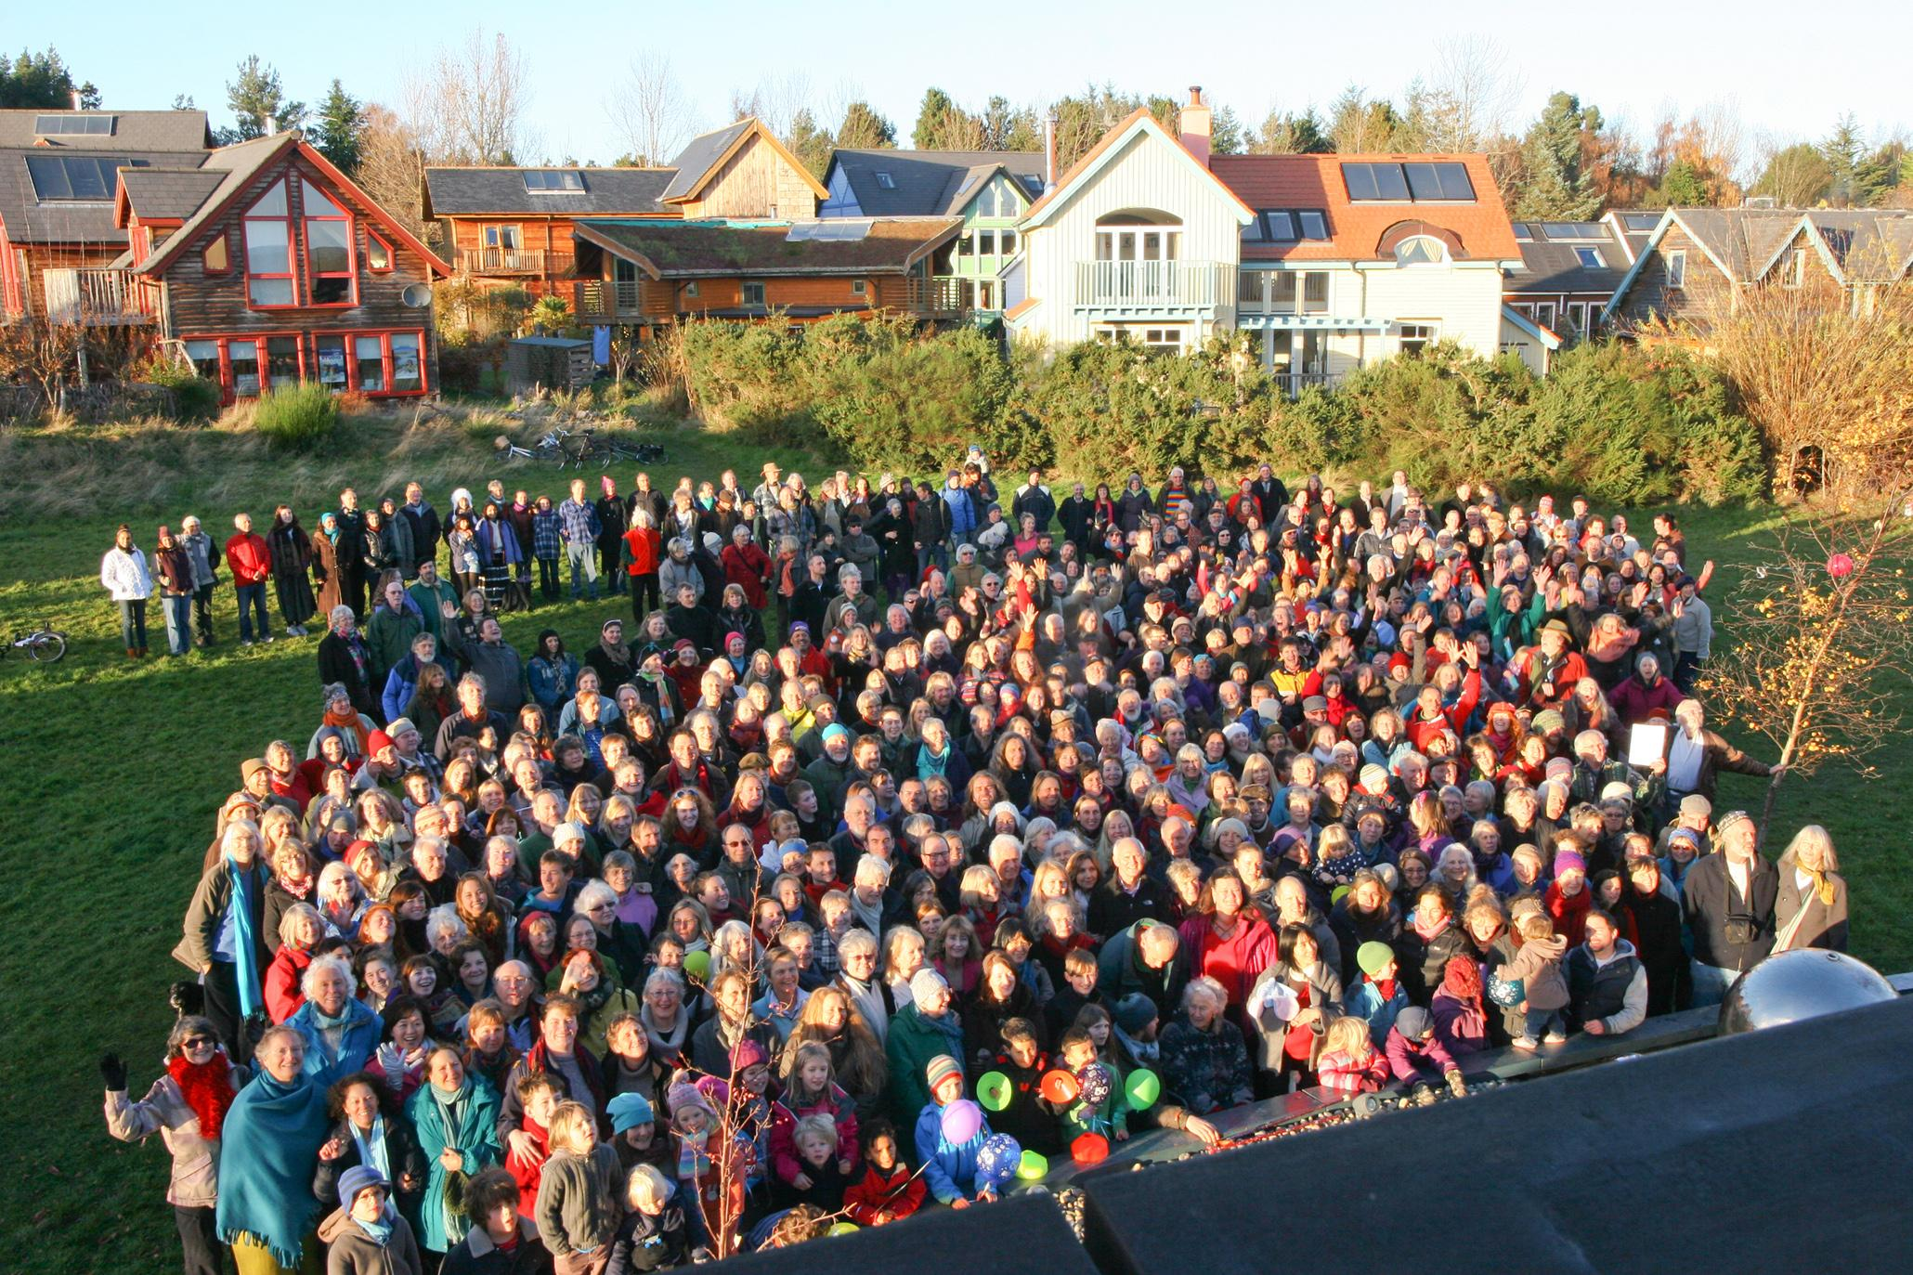
Introduction
People do different jobs.
People earn income for the job they do.
Every job is important.
When people work, they help the community.

Slide 3
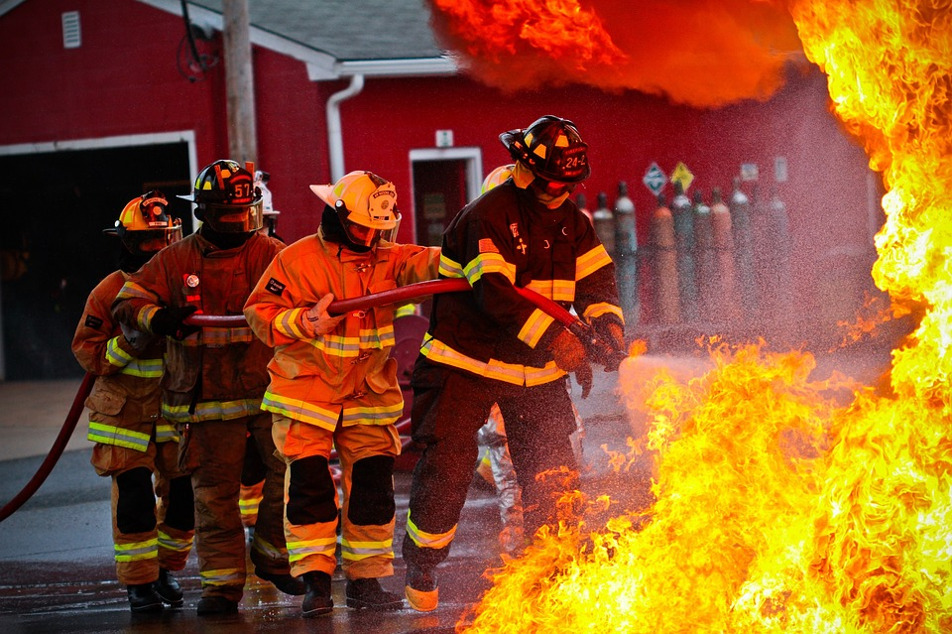
Firefighters
How firefighters help people?
Is their job dangerous?

Slide 4
Teachers
How are teachers important for the community?

Slide 5
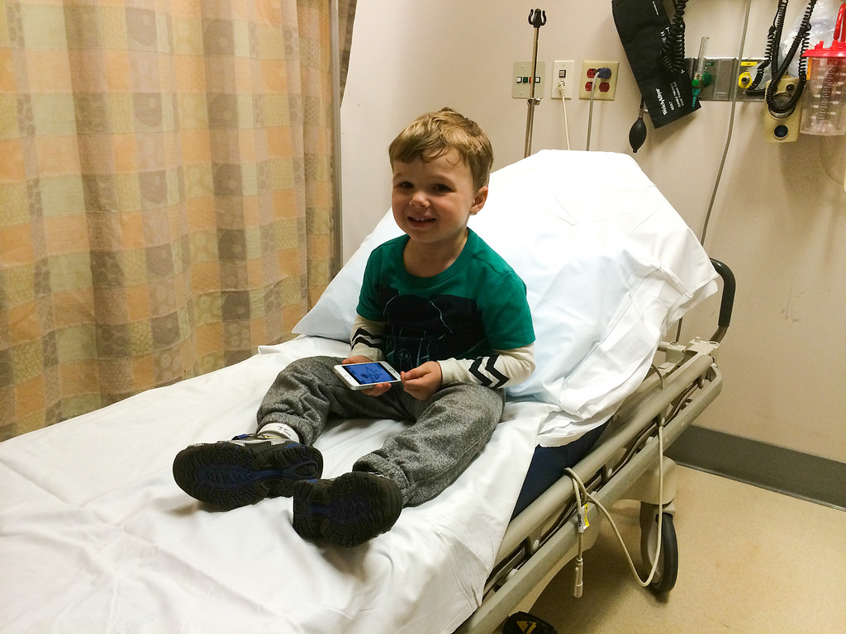
Doctors
How do doctors help people?

Slide 6
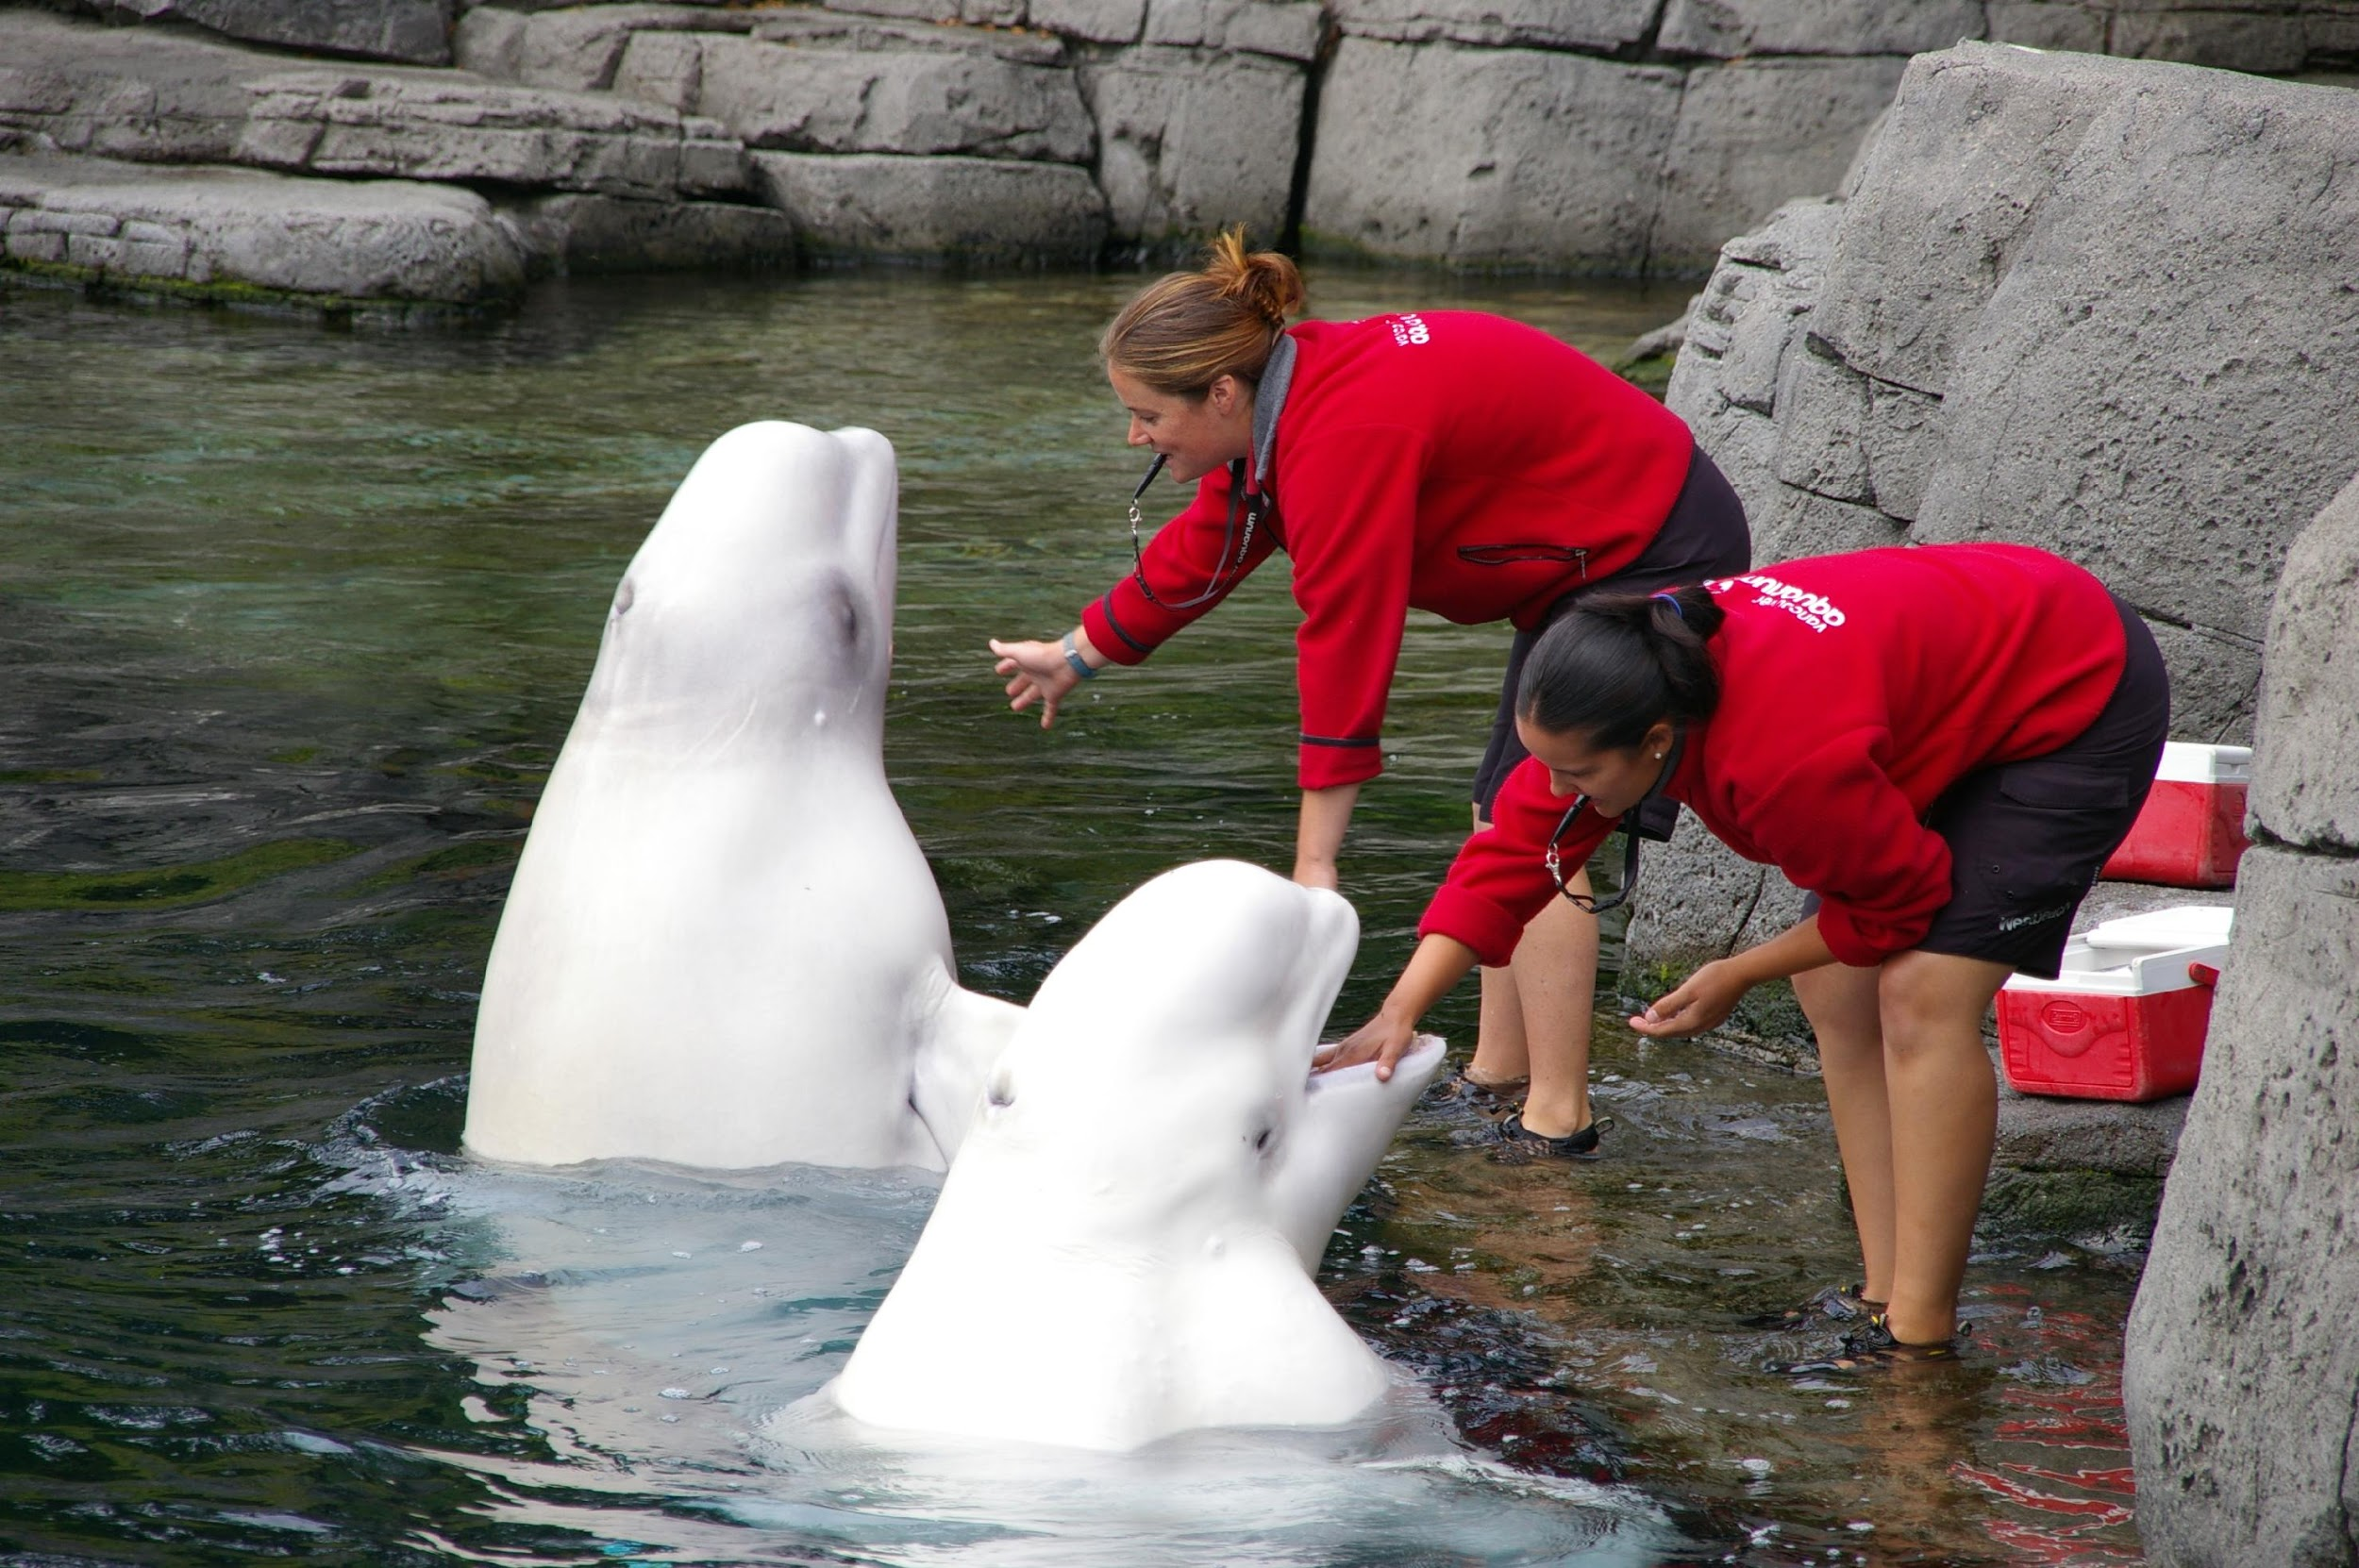
Zookeepers
Why are zookeepers important for the community?

Slide 7
What would you like to do when you grow up?
When I grow up, I would like to be………
Why?
Because, ……………………
How can you help the community with this job?

Slide 8
Compare/Contrast
Firefighters
Zookeepers

